Slide 1
Overview of Janet6 & the e-Infrastructure initiative
Jeremy Sharp
World class research – world class network
The Royal Society, London

Slide 2
Topics
E-Infrastructure initiative and Janet
Janet6 overview
  Requirements to Procurement strategy
  Procurement update
  Timescales

Slide 3
e-Infrastructure

Slide 4
Government national strategy
universities’ role in building a stronger economy
  build stronger links between universities, colleges and industries
aggregation of demand
  promote one common, flexible ICT infrastructure
  re-use in partnership with other public-sector users
use of open standards
  promote interworking
  reduce costs

Slide 5
UK e-Infrastructure initiative
a coherent infrastructure serving academe and industry
  high performance computing
  data-driven storage
  software development
  training and skills
  networks
  security
  authentication
sponsored by BIS
  £158m initial capital funding

Slide 6
Role of Janet
backbone as wide-area network provider
  very high bandwidth requirements posited – “data deluge”
  extend backbone fibre to strategic sites not already covered
  industry use of infrastructure – “open and accessible Janet”
capital funding
prioritising need
  RAL, DL, Chilbolton
  Meteorological Office
  Norwich campus, Genome Campus
e-Infrastructure Leadership Council
  Janet membership and support
contribution to backbone | £10m
extension to strategic sites | £12m
access by industry | £4m
 | £26m

Slide 7
Implications for Janet
assessing need & making a recommendation
  understanding strategic rather than operational needs
  working with and through Research Councils
  Recommendation to be considered by BIS
procurement
  options in initial order for Janet6 for dark fibre
  further orders if subsequently needed (and funded!)
regulation
  extending Janet Eligibility Policy to permit access by industry
  state-aid implications if publicly funded

Slide 8

European dimension
UK e-infrastructure only part of the story
  must connect up internationally
GÉANT: European NREN interconnect
  35 NRENs
  IP and Lightpath services
Commission vision for GÉANT in 2020
  “…the European communications commons, where talent anywhere is able to collaborate with their peers around the world and to have instantaneous and unlimited access to any resource for knowledge creation, innovation and learning, unconstrained by the barriers of the pre-digital world.”
  link to Horizon2020 and CEF funding programmes

Slide 9
Janet6 procurement strategy: Requirements to services

Slide 10
Scope and objectives of the Janet6 programme
Janet6 scope
  “The scope of the JANET6 programme is the replacement of the present contract for the JANET backbone with new arrangements that will remain fit for purpose for a minimum of five years from this time; and the upgrading of regional networks connected to the backbone.”
Janet6 objectives:
    a highly reliable network
    flexible in meeting future demand
    more agile in dealing with change
    increased range of partnerships and collaboration
    increased level of cost control

Slide 11
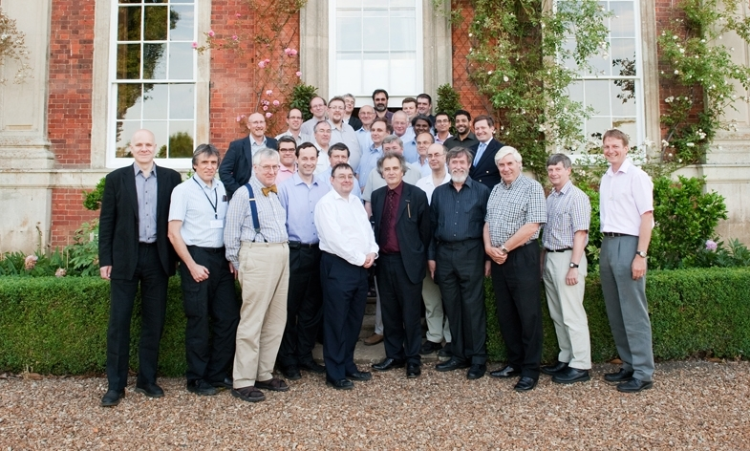
Janet6 research requirements – Chichley, 2010

Slide 12

Requirements gathering
Bandwidth, bandwidth, bandwidth...
Flexibility
Agility
Cost control
Service delivery
Delivery of third-party services
Cloud services
Reliability and resilience
Notes:
Consultation process took place in 2010
Overriding requirement was for bandwidth....
Breakdown into 3 specifics
Flexibility – additional bandwidth wherever its needed in the network
Agility – provisioning additional bandwidth quickly
Cost control – obvious
Service Delivery – we need to build a network that will be able to provide and complement these requirements.

Slide 13
Requirements gathering
Partnerships
Public/public and public/private
Information assurance
Off-net
Anytime, anywhere access
Internationalisation of education
Management of costs
Funding environment
Costs of change
Notes:
Public – NHS is a good example.
Private – Uni’s and Colleges being run as businesses, collaboration with commercial sector.
Funding environment – we all know about this.
Costs of Change – big network procurement and migration every 5 years.
Again, we need to build a network that will be able to provide and complement these requirements.

Slide 14
From requirements to services
Capacity
  Exponential growth continues
    ‘Commodity’ IP networking
    R&E requirements
  Must be able to scale the network
    Access, regional and backbone
  Not just more channels, but faster channels over the network’s life
    100Gbit/s to start
    400Gbit/s?
    1Tbit/s?

Slide 15
From requirements to services
Outsourced services
  Compute, data storage, applications
  Low latency for interactive services
  High bandwidth for bulk data services
Reliability, reliability, reliability …
  National and regional infrastructure
  Access links
  Issue is funding, not operational
    Institutional contribution?
    Smart provisioning to reduce cost?
Notes:
As an aside, who came up with the metaphor of fluffy clouds of water vapour for racks and racks and racks of servers weighing tons and consuming megawatts of power?

Slide 16
From requirements to services
Research
  National and global collaboration
    Interoperation with GEANT and other R&E networks worldwide
    LHC, SKA, ITER, EBI, e-VLBI, Climate (JASMIN)…
  ‘Data deluge’
  Services
    Scalable bandwidth at low cost at provisioning overhead
    dynamic provisioning goal
Support for UK e-infrastructure initiative (BIS)
  Coherent HPC, storage, software and training infrastructure to support the whole of the UK’s research base
  Janet as the underpinning network
    £26m extra initial investment

Slide 17
From requirements to services
Partnerships
  Across the public sector e.g. Health, local government
  With privately funded partners
Need to conform to technical standards
  e.g. PSN information assurance standards
Need for appropriate regulatory frameworks
  e.g. Janet Connection Policy, state-aid risk management, ability to carry public traffic whilst retaining Janet’s privileged private-network status

Slide 18
From requirements to services
Ubiquitous connectivity
  Expectation that students will mainly be off-campus
  Access to Janet from anywhere – via ISPs
  Feeds the capacity requirements
  Feeds the external connection requirements
  Feeds the reliability requirements
Distributed campuses
  Inter-site, intra-organisation connections
  VPN requirements
  More assured international connectivity

Slide 19
Backbone Procurement Strategy

Slide 20
SuperJANET4/5
Getting us out of the cycle of networks that were bursting at the seams at the end of their life
  SuperJANET4: exploiting telco. Investment in new optical technologies
    10Gbit/s technology
  SuperJANET5: dedicated fibre backbone and transmission equipment
    Management of transmission by Verizon, via bespoke contract
    Originally 10Gbit/s, but have upgraded through 40Gbit/s to 100Gbit/s
But still some distance away from the “laser-face” …
  Deployment issues that were contractual rather than operational
  Time to provision, cost management
Notes:
What do we have at the moment? SuperJANET5.
SJ5 and before it, SJ4, got us out of the cycle of networks that were bursting at the seams at the end of their life.
As the prices for bandwidth started to come down, we were able to get ahead of the curve. High capacity circuits in SJ4, then dedicated fibre in SJ5 that allowed us to grow as we wanted – within the limits of what was in the contract with our supplier.
Illustrated by that fact that SJ5 was due to finish in October 2011, but we were able to exercise the option that had been in the contract to extend it to 2013. There is no congestion on the backbone, we hope there won’t be any over the next 18 months. During SJ5, we have been able to scale the network from 10Gbit/s SDH circuits to 40Gbit/s SDH circuits and upwards to be one of the first adopters of 100Gbit/s ethernet at any sort of scale in the UK. We have now been running 100GE for a year, and there aren’t many people that can say that.

Slide 21
Backbone procurement strategy
    Options appraisal
      Procure dark fibre infrastructure
      Procure optical transmission equipment
      Management in-house by the Janet NOC
    Why? Agility
      Janet NOC will have a view from the fibre up the stack to the routers
      Fewer contract/administrative boundaries or chains to cross
      Directly translate the community’s requirements into engineering
    Why? Different contractual vehicles for fibre and equipment
      Fibre: long-term, little need to change
      Optical equipment: rapidly evolving, highly competitive
competitive
dialogue
procedure
Notes:
Options appraisal:
- Every project of this size has one ☺
- Range from ‘do nothing’, to ‘do the same thing again’, all the way to ‘do something completely different’.
Decided on something in the middle.
Competitive Dialogue
Complicated requirements
Benefit of discussing with bidders to understand the market
In-house Management
Existing experienced IP NOC with some optical expertise.
Develop optical expertise and skills.
Some other NRENs (NORDUnet) have separate NOCs.
End up with a single combined NOC.

Slide 22
Fibre procurement strategy
Fibre & PoP Procurement
    Lot 1: Fibre & PoP Infrastructure in the UK
    Options: Scotland, Ireland, Aurora, London, strategic national research campuses
    Lot 2: Fibre Infrastructure in Ireland
    Framework Agreement(s) for 4 years
        Initial order of 10 years with an option to extend for a further 5 years
Notes:
Explain detail and reasons behind each Option in Lot 1.
Explain detail and reasons behind Lot 2.
Difference between Framework and Orders
- Framework is vehicle to place orders (without going to procurement).
Orders are placed standalone, each order results is a separate contract.
Tending towards a 10 to 15 year term, for obvious reasons (price).

Slide 23
Lighting the fibre
DWDM optical transmission equipment
  Multiple channels on a single fibre,
  Each a separate frequency of light on the fibre (“wavelength” or “colour”)
    c.f. different frequencies for different radio stations in broadcasting
Next-generation technology
  Needs to be more reconfigurable than SuperJANET5
    e.g. one of the collector arcs in Scotland required 13 engineers to be dotted along it at the same time to commission …
“Native” capacity on the core to be 100Gbit/s
  Theoretically 80 channels of 100Gbit/s per channel
  Roadmap for 400Gbit/s and 1Tbit/s

Slide 24
Equipment procurement strategy
Transmission equipment procurement
        Supply, design, delivery, installation, commissioning, maintenance, training, specialist technical support
        Framework Agreement for 7 years
        Initial order 5 years
Notes:
Explain detail and reasons behind the different areas of scope
Difference between Framework and Orders
- Framework is vehicle to place orders (without going to procurement)
Orders are placed standalone, each order results is a separate contract
Initial order – multiple break points enable us to review services.

Slide 25
Procurement Status

Slide 26
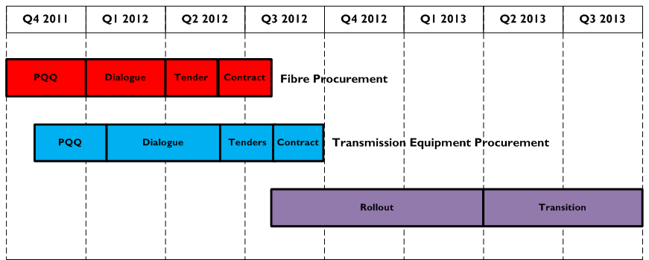
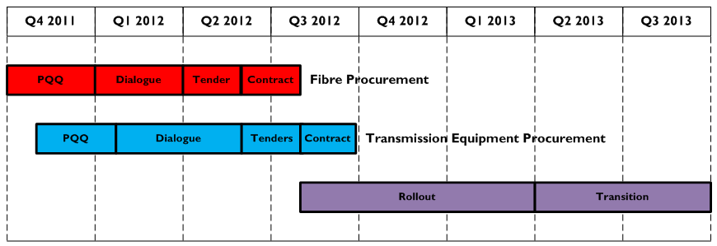
Timeline

Slide 27







Fibre procurement
OJEU procurement
Competitive dialogue
Launched October 2011
Shortlisted 6 for dialogue
Selected SSET as preferred bidder
Target to conclude contract by end July
Notes:
Launch: notice in OJEU.
Purpose: select a shortlist of capable suppliers.
Process: bidders fill in questionnaire, panel evaluate and select.

Slide 28
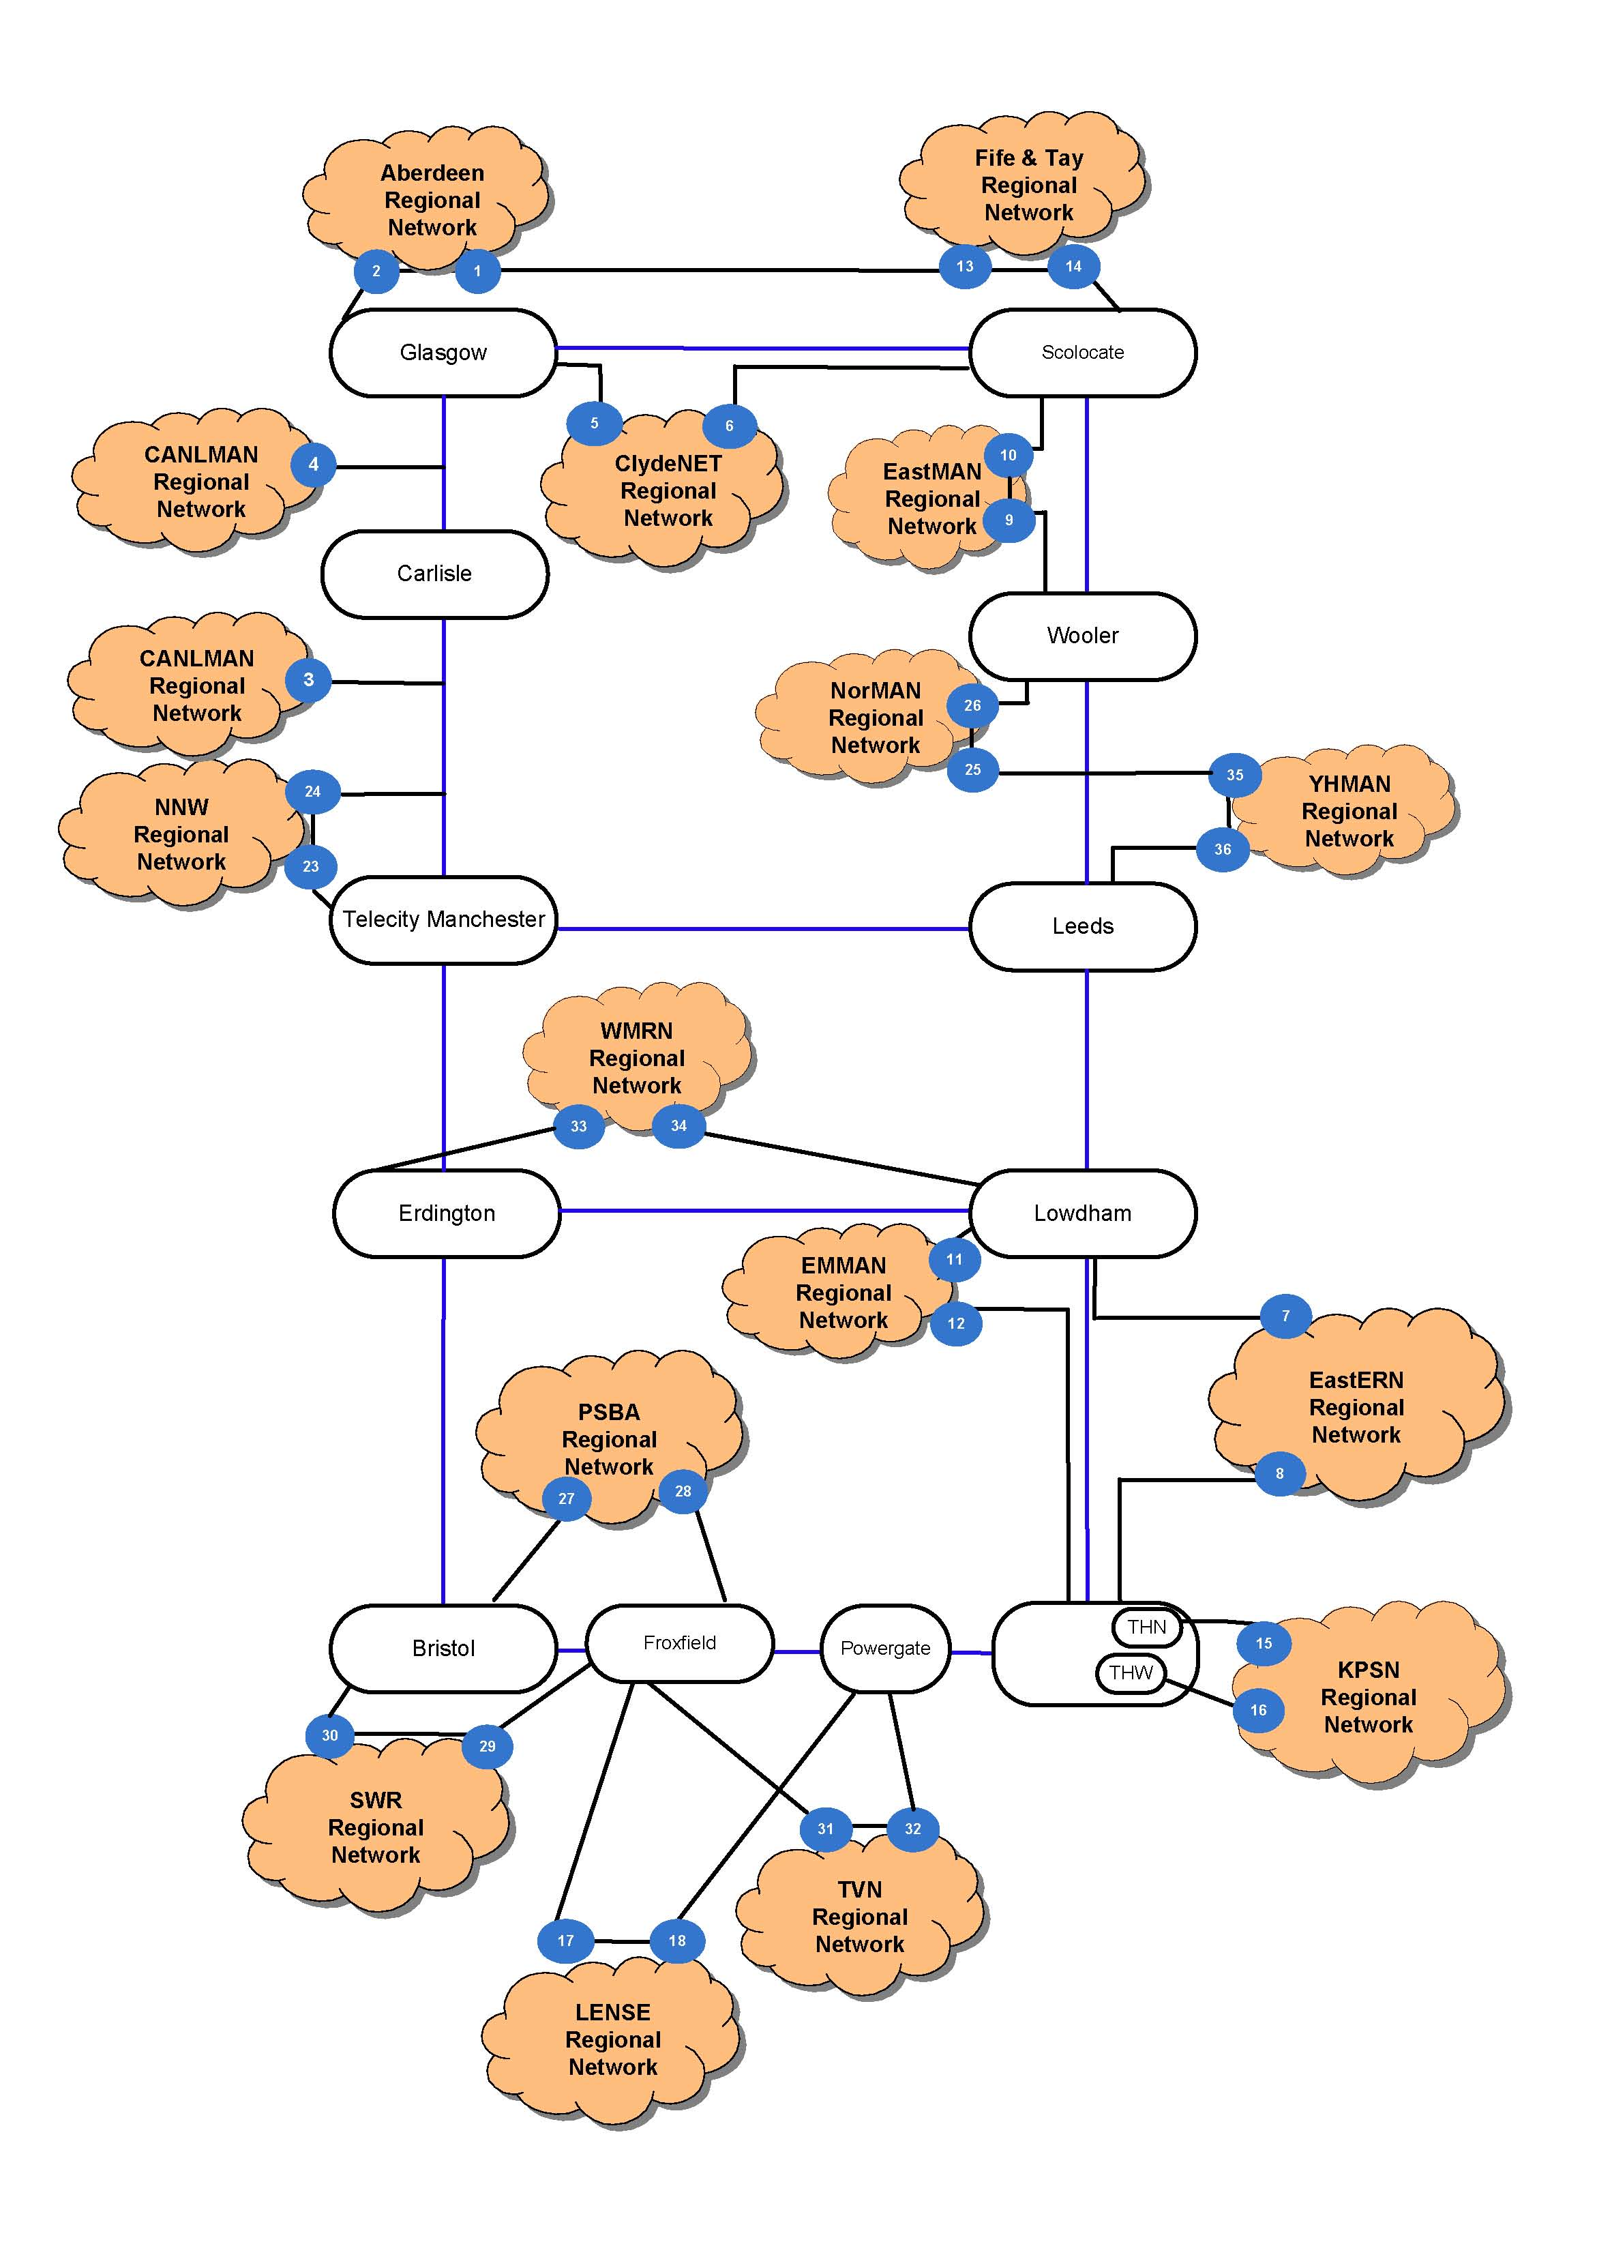
Fibre & PoP infrastructure
Fibre infrastructure stats
6400 km fibre
91 PoPs (38 of which are SSET’s)

Slide 29





Transmission equipment procurement
OJEU procurement
Competitive dialogue
Launched November 2011
Shortlisted 6 for dialogue
At final tenders stage
Target to select preferred bidder by July
Conclude contract by mid-Sept
Notes:
Launch: notice in OJEU.
Purpose: select a shortlist of capable suppliers.
Process: bidders fill in questionnaire, panel evaluate and select.
5 equipment vendors.
1 systems integrator (offering equipment from one of the 5 vendors)

Slide 30
Timeline

Slide 31
Janet6 multi-service architecture
service development
general use
e-research
network R&D
IP production network
test-beds
test-beds
new service
Janet Lightpath
bandwidth
innovation
flexible transmission platform
Janet operations
Optical transmission
Fibre infrastructure

Slide 32
Summary: Janet, a world class network supporting world class research
A specialist network (technology, architecture, operations, policy) with a core mission to support research
Global reach
  A key element of an integrated e-infrastructure eco-system of experimental facilities, sensor networks, HPC, data storage, access management
Richness of support for collaboration
Customer engagement tuned to respond to research agendas
Notes:
Explain detail and reasons behind the different areas of scope
Difference between Framework and Orders
- Framework is vehicle to place orders (without going to procurement)
Orders are placed standalone, each order results is a separate contract
Initial order – multiple break points enable us to review services.

