Slide 1
UK e-Infrastructure: an Industry Perspective
Darren Green FRSC
GlaxoSmithKline

Slide 2
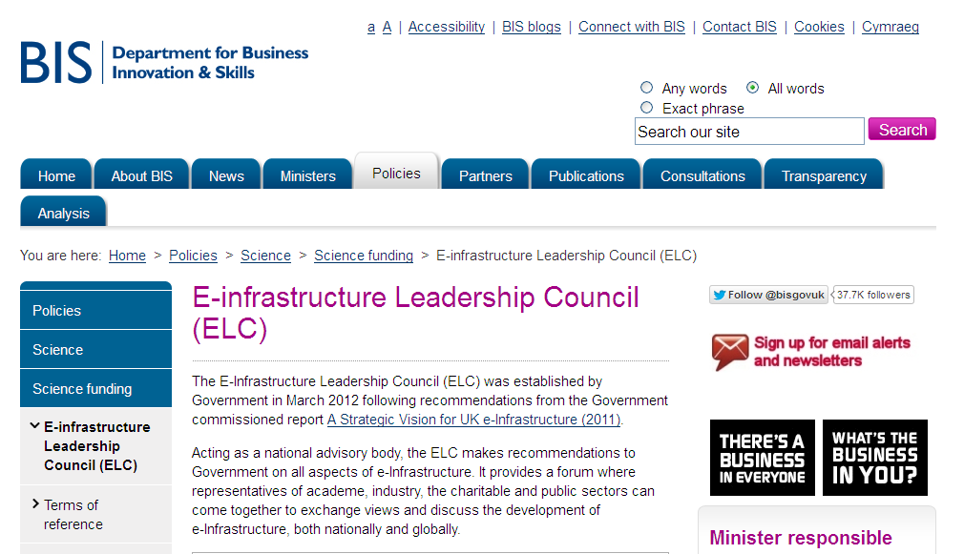
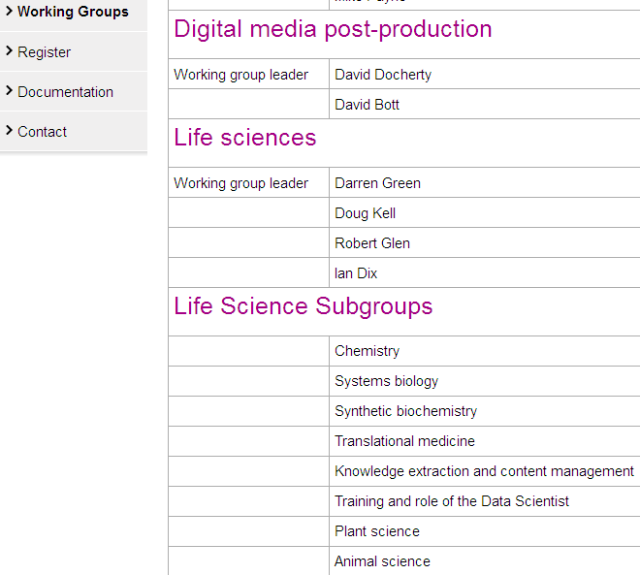
UK e-infrastructure Leadership Council

Slide 3
Lifesciences and the UK economy
“The UK life science industry is one of the world leaders; it is the third largest contributor to economic growth in the UK with more than 4,000 companies, employing around 160,000 people and with a total annual turnover of over £50 billion. Its success is key to future economic growth and to our goal to rebalance the economy towards making new products and selling them to the world. Globally the industry is changing with more focus on collaboration, out-sourcing of research and earlier clinical trials with patients”
David Cameron, 5th December 2011

Slide 4
The R&D Productivity Gap
Source: Burrill & Company; US Food and Drug Administration.
Note: NMEs do not include BLAs

Slide 5








UK “Big Pharma” Research sites 2001

Slide 6
UK “Big Pharma” Research sites 2012

Slide 7
GSK is evolving from a monolith
External
Resources
CEEDD
Virtualization of Drug Discovery
CEDDs
Pharma
Internal
Resources
Centralized
Control/Management
De-Centralized
Control/Management

Slide 8




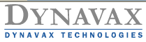






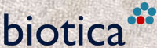


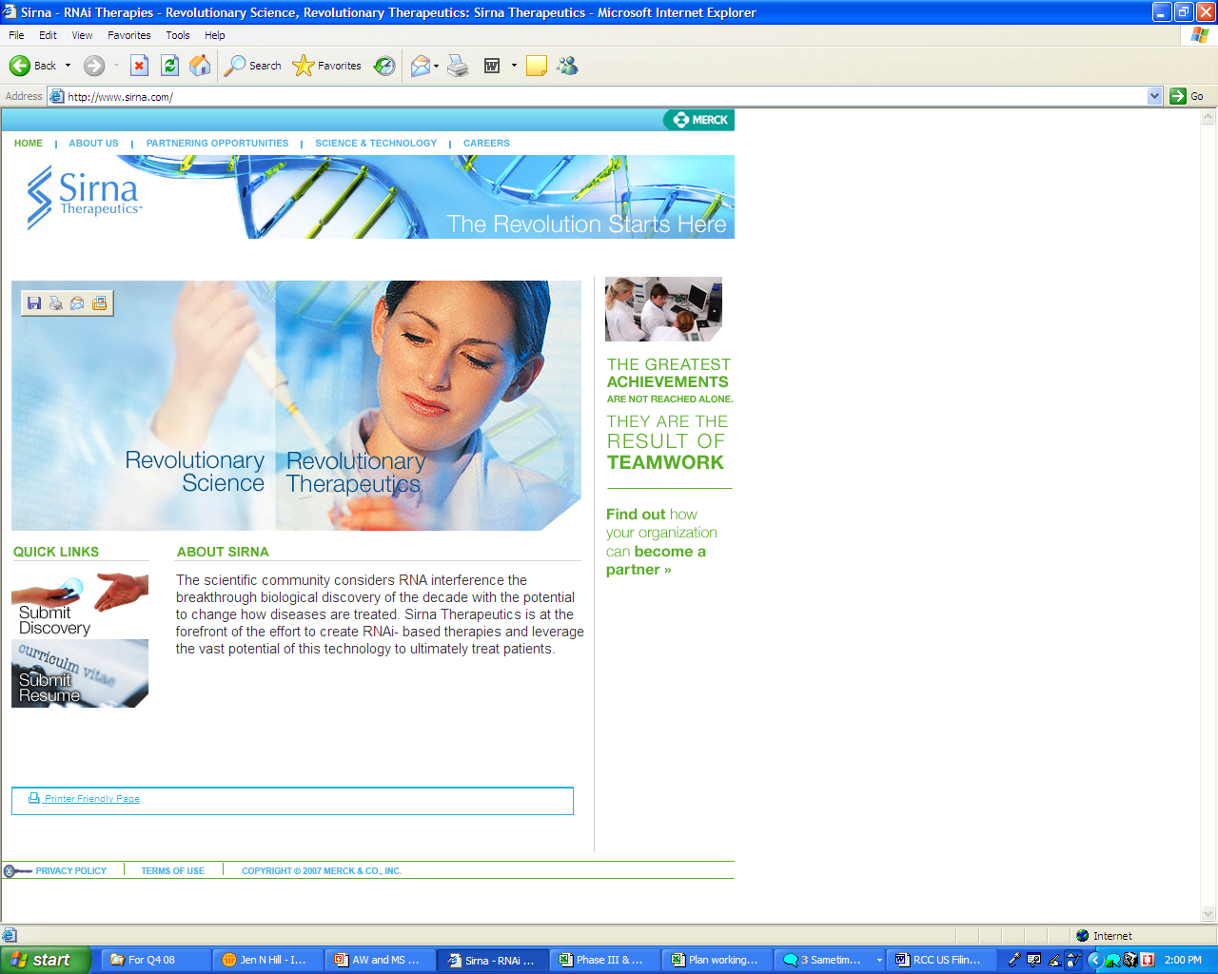


























Adding external efforts to internal research
New/expanded in 2008/2009
35 external engines
>40 internal engines
Corporate
Venture Fund

Slide 9
Lead Optimisation within Drug Discovery

Slide 10
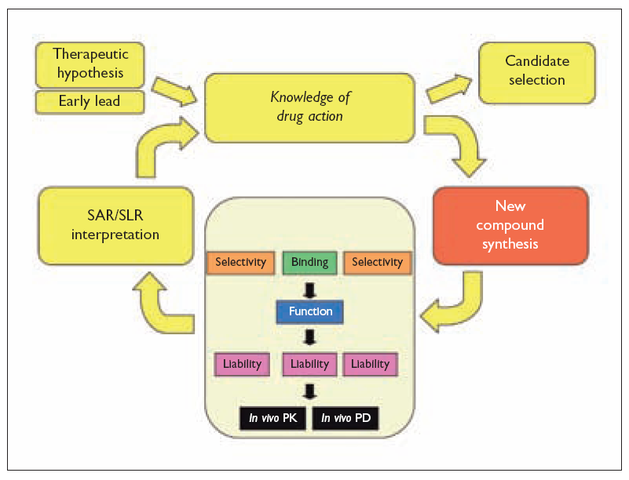
The Lead Optimisation cycle

Slide 11
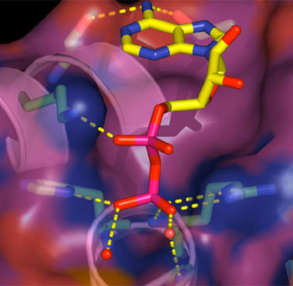
“Rational” drug design
Most design methodologies are aimed at reducing the number of cycles in lead optimisation- ideally to 1!
All design methodologies, to date, have had limited success in this regard

Slide 12
A multi-objective optimisation
Lead
Potency
X
Safety
Drug
X
Absorption
Solubility
PC2
Metabolic
stability
PC1
Desired- faster navigation through multi-dimensional space, by reducing the cycles
or speeding them up
Traditional Way: Sequential Process, Costly, Lengthy

Slide 13
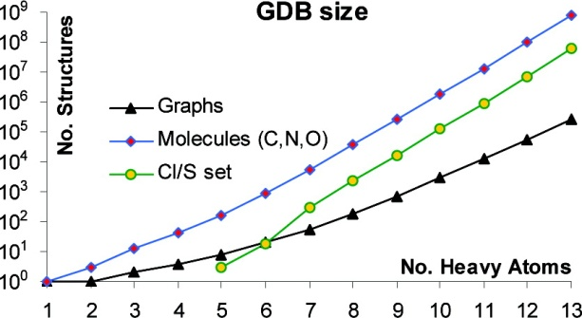
A huge search space
Small organic molecule property space:
  Atomic basis set small for organic reagents
    H, C, N, O, S, F, Cl, Br, P
  Carbon connectivity is not just linear
  Approximately 10²⁷ molecules of 25 atoms
  References:
    Fink & Reymond, J. Chem. Inf. Model. 47 (2007) 342-353
    Fink et al., Angew. Chem. Int. Ed., 44 (2005) 1504-1508
    http://www.dcb.unibe.ch/groups/reymond/

Slide 14
Typical HPC usage
Coarse grain parallelisation
  Same calculation across large numbers of molecules
  Simple properties
Docking/scoring
Quantum mechanics
Decreasing
Frequency of use

Slide 15
Lead Optimisation within Drug Discovery

Slide 16
Green Chemistry
Sustainable Development :“meeting the needs of the present without compromising the ability of future generations to meet their own needs”. *
Green Chemistry**: “To promote innovative chemical technologies that reduce or eliminate the use or generation of hazardous substances in the design, manufacture and use of chemical products.”
* United Nations Commission on Environment and Development in 1987
** US Environmental Protection Agency 1990s

Slide 17
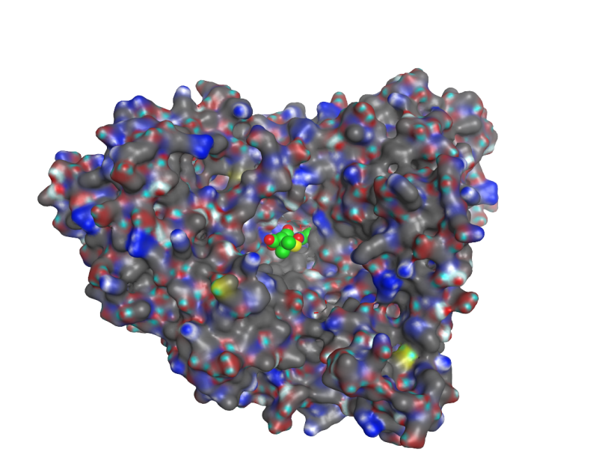
Enzyme design
Proteins that catalyse a chemical reaction
Substrate + Enzyme = Product + Enzyme
Proteins are linear assemblies of amino acids that have a biological function

Slide 18
Example: Penicillin G Acylases in the production of semi-synthetic penicillins and cephalosprorins
Pen G Acylase (PGA) has been used since the 60s to make 6-amino penicillanic acid (6-APA) from Penicillin G
More recently, it has also been used in the reverse direction to synthesise penicillins and cephalosporins by catalysing the condensation of phenylacetic acid derivatives with a beta-lactam

Slide 19
The challenge
To be able to design enzymes which are able to synthesis precisely the drug substance that is required, with the efficiency needed for manufacturing
This will require
  Libraries of existing enzymes for standard chemical bond formation (e.g. amides)
  Reliable methods for ab initio design/evolution of novel enzymes for specific purposes
Synthetic Biology has been identified by the Technology Strategy Board as a priority area of investment

Slide 20
A(nother) huge search space
Protein property space:
  20 amino acids in ~10 groups
    G, A, S/T, C, P, D/E, R/K, N/Q, H/F/W/Y, I/L/M/V
  Linear combination of amino acids
  20^{n} permutations
  For N = 100 (a rather small protein) the number 20¹⁰⁰ (~1.3x10¹³⁰) is already far greater than the number of atoms in the known universe. Even a library with the mass of the Earth itself— 5.98x10²⁷ g—would comprise at most 3.3x10⁴⁷ different sequences

Slide 21
Rational approach
Use x-ray diffraction crystal structure information
  View in graphics software
Identify binding pocket
Identify (or propose) binding mode
  Information from similar ligands or molecular docking software
Identify amino acids surrounding pocket
Find bacterial sequences with variants in pocket
  Use multiple sequence alignment

Slide 22
HPC applications
QM/Simulation for rational approaches
  Ability to test millions of mutations in silico
Empirical/statistical algorithms for efficient searching/sampling very large search spaces

Slide 23
Translational Medicine
Biomedical research that aims to translate between Clinical Practice and Laboratory research.
Most translational studies are focused on the identification and validation of biomarkers that are testable in patients, including markers that are predictive of:
  the prognosis of disease (severity)
  how well a patient may respond to a pharmacological therapy
  the susceptibility of a patient to side effects of therapeutic intervention
  the identification of subgroups that are at increased risk for disease

Slide 24
Potential Impact of Translational Medicine
Clinical trial design
Design of diagnostics
Targeted prescribing of medicines
Personalised Medicine

Slide 25
What needs to come together?
Scientific Discipline | Infrastructure Components
Clinical Sciences | Document Management to manage trial approval and patient consent forms Electronic Case Report Form (eCRF) data collection system Clinical Data Management platforms Clinical Statistics Platforms Medical History records (eHRs)
Biobank | Document Management to manage trial approval and patient consent forms Laboratory Information Management Systems (LIMS) for tracking the location of samples
Biological Sciences (Bench) | Electronic Notebooks to capture of specific experiments
Biological Sciences (High Dimensional Biology) | LIMS systems to organise workflow and capture results files Data Storage Archives to store large primary data files from analytical platforms (imaging, NGS, omics, etc)
Biostatistics/Bioinformatics | Statistical/Data programming environments for processing and analysing data Reference Databases of biological information
Knowledge Management/Systems Biology | KM tools to capture results and output of all experiments Modelling tools to combine data from all domains for analysis Reference knowledge (literature, pathway knowledge, etc)

Slide 26
The infrastructure challenge
Re-useable, secure infrastructure service and components that can be rapidly re-deployed and configured for cross-organisational investigations.
The key features of such a platform include:
  multi-terabytes of storage
  rigorous access control (critical in handling patient data),
  data governance and curation services
  standardised dictionaries, ontologies and APIs
  ETL tools to carry out loading of data, high bandwidth connections to data provision centres
  data modules enabling the management a wide range of data modalities
  patient and sample leve data tracking (enabling data retraction)
  collaborative search and analytics tools
  virtual team collaboration spaces
All of which are available as a sustainable service which can either host multiple collaborations or be flexibly deployed to meet the needs of specific collaborations.
On top of this such an infrastructure needs secure connections with medical eHR systems, biobanks and LIMS systems.

Slide 27
HPC usage by industry: current
Internal systems:
  Linux clusters
Commercial
  Small use of commercial clouds
Some examples of large public cloud usage:
  Inhibox/Amazon

Slide 28
Industry use of UK e-infrastructure
“In the domain of high performance computing for life sciences, the Science and Technology Facilities council (STFC) runs an e-science project with a 10-year history. We are not aware of any life science company that makes of these resources”*
* Response from the industry leads of the EU OpenPhacts IMI project to UK Research Council 2012

Slide 29
Barriers we need to overcome
Industry engagement
Software
Security
Data transfer
Domain Knowledge

Slide 30
Summary
Industrial applications of HPC are emerging
Lifescience research increasingly involves collaboration
Requirements of lifesciences companies are diverse
UK HPC will need to evolve and differentiate itself from commercial offerings
There is an opportunity for us to create something unique

