Slide 1

Liberate
Our fully managed solution for access management

Slide 2
Presentation goals
Explain the service
Set out the timelines
Questions and answers

Slide 3
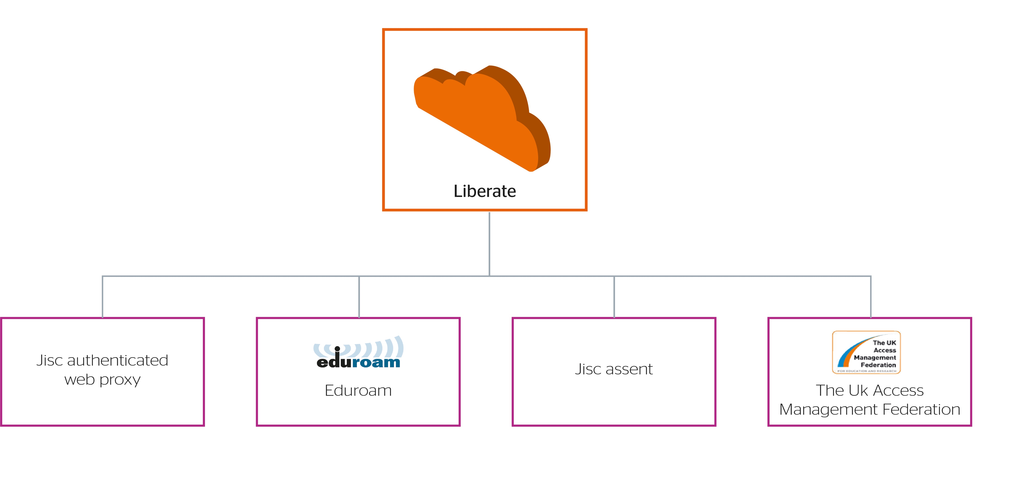
What is Liberate

Slide 4
The problems
Today, institutions must integrate their systems with these services separately. This integration can:
Require a significant amount of staff effort
Cost money, if buying and monitoring solution
Add to the overall complexity of service delivery
Possibility of a loss of knowledge if a team member leaves.

Slide 5
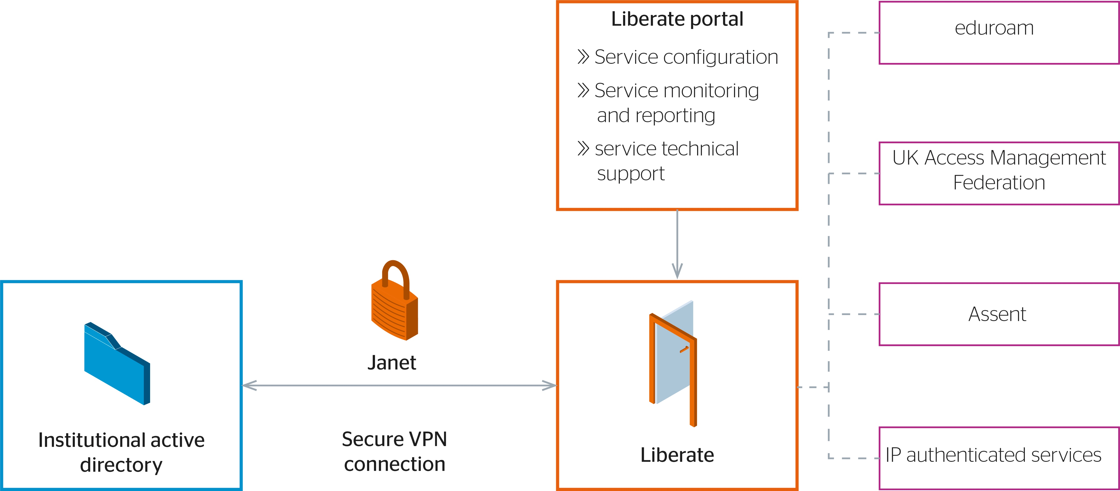
How it works
Liberate provides a gateway between the college or university’s active directory and Jisc access management services

Slide 6
Just five steps from start to finish
1
Tell us which components you want to subscribe to
2
Deploy the provided VPN VM image (or use your own OpenVPN endpoint if you prefer)
3
Using the Service Portal, connect Liberate to your Active Directory (or other LDAP directory)
4
Using the Service Portal, configure attribute definitions and authorisation policies
5
Relax

Slide 7
Why Liberate
A comprehensive solution
Peace of mind
The only solution that supports all three of Jisc’s access management services – plus IP address authentication
A single solution reduces the time and effort spent managing multiple solutions
Developed and operated by Jisc, the leaders in access management services for education and research.
Connected to the trusted Janet network, it also benefits from our advanced security capabilities
WHY?
Enjoy new efficiency savings
A flexible and attractive tariff
A fully-managed service that is supported by our world-leading team of technical experts, freeing your staff to spend their time more productively
A competitively priced tariff, with no hidden costs
Pay only for the components you need

Slide 8
Explaining the timelines
We are prioritising the introduction of the most requested components, and so their release will be staggered
We will operate a beta programme in parallel to the production service, allowing a smooth transition for early adopters
This provides confidence that each component is fit-for-purpose on transition from beta to production
Moving forwards, all new components and significant developments will be trialled in the beta programme

Slide 9
Timelines
Early 2017
AMF only
24 July 2017
AMF Authenticated web proxy Eduroam (home) Assent (home)
2 October 2017
Authenticated web proxy
AMF Eduroam (home) Assent (home)
2 January 2018
Authenticated web proxy Eduraom (visited)
AMF Authenticated web proxy Eduroam (home) Assent (home)
Pilots
Today
Beta
Beta
Beta
Production
Production

Slide 10
Liberate summary
It’s the most comprehensive and cost-effective solution for an institution’s access management requirements
It’s a fully-managed solution that will release staff time to allow them to focus on other priorities
It’s designed and operated by the world-leaders; no other provider matches our
pedigree, expertise, and capabilities
We have an exciting product roadmap, and there will be opportunities to steer future product development
It’s going global, in partnership with other NRENs and resellers

Slide 11
Need to ask a question later?
liberate@jisc.ac.uk

Slide 12
Thank you for your attention
Joe Steele
Managed services operations manager
Joe.Steele@Jisc.ac.uk

