Slide 1
East Scotland
John Littledale
Service Lead
Network Services Group
Janet(UK)
john.littledale@ja.net
01235 822303

Slide 2
Janet Service Management
Service Managers assigned to Janet Regions
Engage with Stakeholder Groups
Feed back into the company
Lifecycle Management of the Janet Regions
  Project Management

Slide 3
Interaction with Individual Customers
Act as escalation point
Find solutions
  Availability
  Bandwidth
  Inter-site connectivity (North East Scotland College)

Slide 4
What Janet Does
Service Level Monitoring
Capacity Planning
Incident Management
Monitoring and control etc ...
  Basically everything you would expect from a company running a service

Slide 5
Service Review
Or what we think you might want
  Service Level Commitment reporting
  Capacity Reporting
  Major incidents affecting the region
Janet Primary IP Service

Slide 6
Service Review
When we think you might want it
  On a quarterly basis
  In advance on the meeting?
    If so how far in advance?
  At the meeting?

Slide 7
Service Commitment
Service catalogue
  Connections
  https://www.ja.net/products-services/janet-service-commitment
  Includes
    Hours of service
    Target availability
    Fault management
    Resilience
    Security
    Charges
    Service delivery time
    Escalation
    Terms and conditions

Slide 8
Service Details

Slide 9
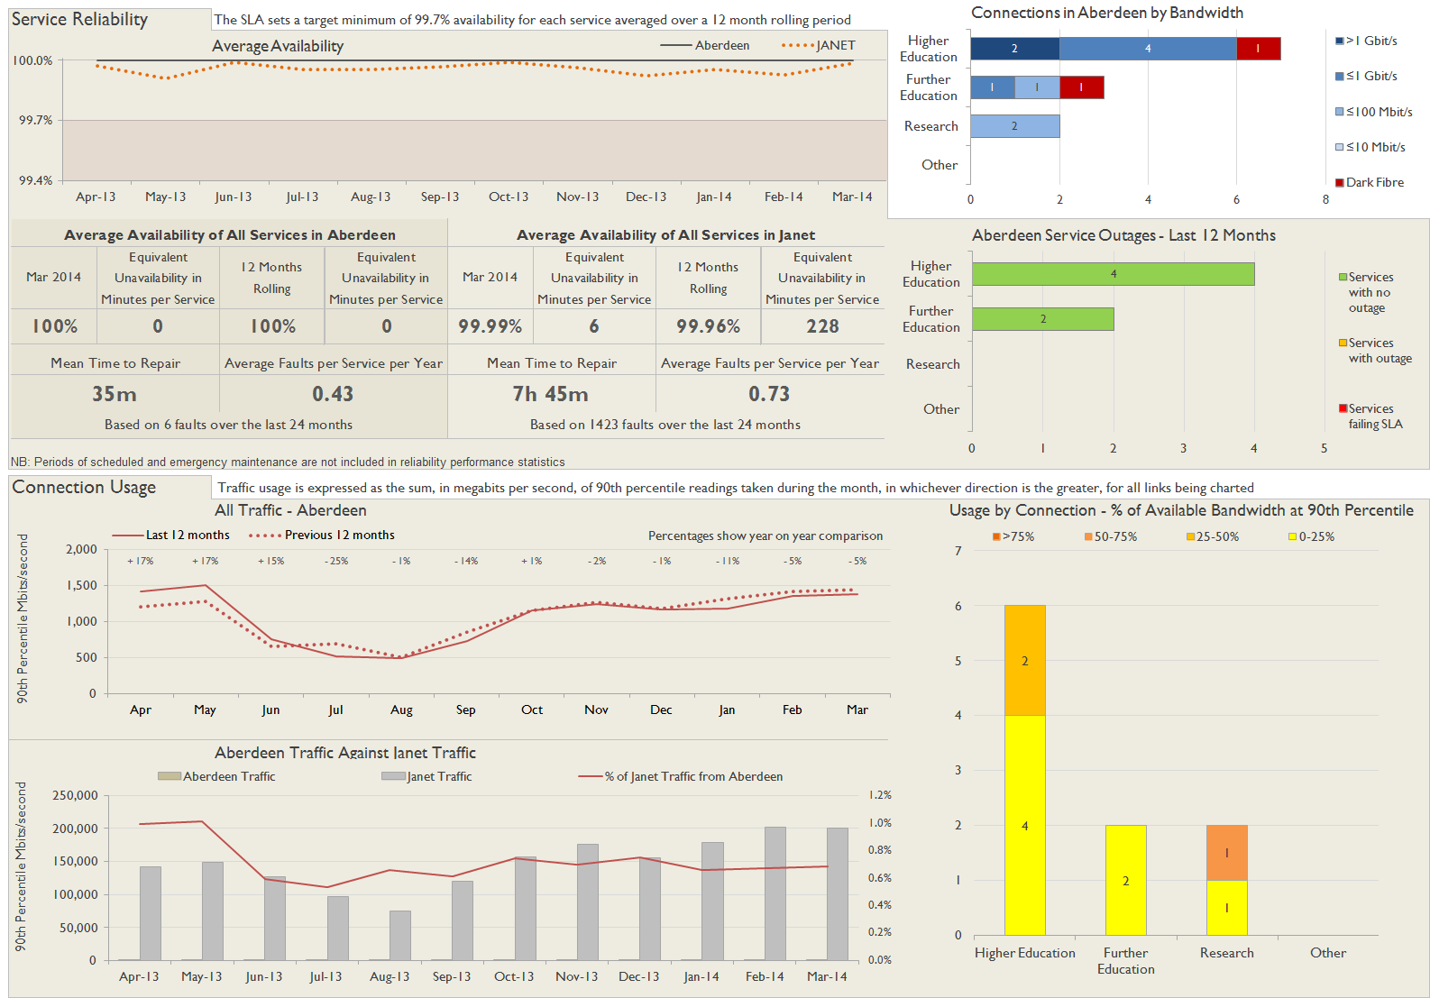
Usage

