Slide 1
Trust me, I’m an engineer: Engineering trust using a Trust Router infrastructure
John Chapman, Janet
Fall 2012 Internet 2 Member Meeting
3 October 2012

Slide 2
Trust me...
What do we mean by ‘Trust’
Trust infrastructures
Trust in a Moonshot Service
Trust Router – a new concept
Questions
Photo Credit: (CC) BY-NC-SA by szczel

Slide 3
What is trust engineering?
Trust engineering is concerned with the design & construction of trust infrastructure
Trust infrastructure helps actors make reasoned decisions about appropriate trust in other actors
Trust infrastructure consists of:
Policies that set expectations
Technologies that derive the trust decisions
Applications that leverage/exploit the decisions

Slide 4
Trust engineering – a science and an art
Why ‘science’?
Involves application of ideas and methods from computer science (often, but not exclusively, cryptography)
Why ‘art’?
How we reason is a function of our cultural & socio-economic environment (social conventions, legal systems, business context, etc.)
Infrastructure is tangible; reasoning is intangible

Slide 5
Reasoning the Chasm of Incredulity
Leap of faith
Induction
Empiricism
Trusted knowledge
Chasm of Incredulity
A proposition
Piranha Pond

Slide 6
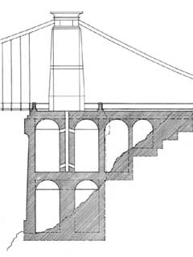
Induction, empiricism, trust & fallibility
Clifton suspension bridge, Bristol (planning commenced 1753; constructed completed 1864)
“The pier on the Leigh Woods side stands on a 33 metre red sandstone abutment. For a hundred and fifty years it was believed the support was solid. But amazingly in 2002 it was discovered the abutment was actually hollow - made up of a sequence of gigantic chambers.”

Slide 7
Trust Apple...
http://theamazingios6maps.tumblr.com/post/31927133859/something-very-heavy-crossing-the-clifton

Slide 8
Important R&E trust infrastructures today
Organisation
Kerberos / Windows Domains for corporate ICT services
Various Web SSO solutions using variety of hacks/technologies
National/Regional
Web SSO federations, principally using SAML metadata PKI
National/European Grid Infrastructure(s) using x.509 PKI
Other x.509 PKI initiatives (e.g., GÉANT’s eduPKI)
Global
Internet x.509 PKI (with TERENA enabling purchasing aggregation)
IGTF, principally using x.509 PKI
eduroam using RADIUS (and RadSec/x.509 PKI)
eduGAIN using SAML metadata PKI

Slide 9
Some reflections on these trust infrastructures
Our customers would prefer to deploy fewer technologies; and preferably just one
However a single trust technology must support the policy requirements of a broad range of communities distributed across our customers; there is no “one size fits all”
Today’s hierarchical organisation of R&E trust infrastructure (campus → national → regional → global) is increasing irrelevant to our customers, who need multiple trust infrastructures (not multiple technologies!) reflecting their relationships with other organisations globally

Slide 10
Where we are & where we want to get to
Trust technology
Use cases
Communities

Slide 11
Collapsing to a single trust technology
Use cases spanning one or more communities
Community
Community
Community
Baseline Trust Policy

Slide 12
Current Federations
Identity federation
Based on SAML technology
Typically for making security claims for web single sign-on
eduroam service
Based on RADIUS technology
Typically for making security claims for network single sign-on
Certificate service
Based on X.509 technology
Typically for making security claims for SSL-based applications

Slide 13
Lower the barriers to business between our customers
Reduce the cost and time to market for new services
Drive down operational costs for both Janet and our customers
Allow communities themselves to create and run communities
Unify a complex set of trust establishment techniques

Slide 14
Community-centric Federation
Helpful to segregate communities into logical groups
‘Community of Registration’ (CoR)
A collection of registrations representing each customer
Common registration policy is relatively easy to define (e.g., NIST 800-64, WebTrust, etc)
‘Community of Interest’ (CoI)
A collection of these customer representations
CoIs have any kind of policy; very difficult to normalise

Slide 15
CoRs and CoI
C
D
Janet Community of Registration
“Janet customer” Community of Interest
“Local government” Community of Interest
“Health services” Community of Interest
B
E
A
F
A
B
E
D
D
C

Slide 16
Technology requirements
Efficient & robust
Significant scalability
Janet’s target use cases imply 100Ks of RPs
Support for numerous and diverse communities
These will be organised arbitrarily, across many organisational and national boundaries
Integration with diverse use cases & applications
One trust technology, supporting multiple trust infrastructures, for any use case

Slide 17
Introducing…
…Trust Router

Slide 18
Janet’s Trust Router
The final major output of Project Moonshot: https://community.ja.net/groups/moonshot
A next generation trust infrastructure for ABFAB-based federated identity systems
Implements draft-mrw-abfab-trust-router
Functional Specification: https://community.ja.net/groups/moonshot/documents/draft-trust-router-specification

Slide 19
Terminology
Trust Link – asserts that one Trust Router is willing and able to forward Trust Path Requests to another TR or AAA Server
Trust Path – set of Trust Links that can be used by a specific Relying Party to reach an AAA Server in the domain of a specific Identity Provider
A(T)->B(T) – a Trust Link between two Trust Routers for realms A and B

Slide 20
Trust Router Protocol
C
B(T) ->C(T)
C(T)->C(A)
B(T)->E(T)
E(T)->F(T)
F(T)->F(A)
C(T)->C(A)
B
Realm C
AAA
A
E(T)->F(T)
F(T)->F(A)
D(T)->E(T)
E(T)->F(T)
F(T)->F(A)
E(T)->F(T)
E(T)->F(A)
D
E
F(T)->F(A)
F
Realm F
AAA

Slide 21
Trust Path Query
0 – Trust Router Protocol
Relying Party domain
Identity Provider domain
1 - Trust Path Query Request
4 - Temporary Identity Provisioned
2 & 3 - Trust Path Traversal
5 - Trust Path Query Response
7- Temporary Id lookup
AAA
client
AAA
server
6 - AAA Authentication

Slide 22
Project Moonshot
Milestone | Date
Management Portal Specification complete | October 2012
Windows SSP public beta available | November 2012
Introduction to Moonshot Webinar | 14-Nov-12 (tbc)
Identity Selector v1.0 available | December 2012
Windows SSP v1.0 available | January 2013
Trust Router Public beta available | January 2013
Moonshot Implementation Training Course Pilot | February 2013
Trust Router v1.0 available | March 2013
Moonshot Implementation Training Course | March 2013
Service Pilot begins | April 2013

Slide 23
Get involved!
https://community.ja.net/groups/moonshot/documents/draft-trust-router-specification - TR Functional Specification
http://community.ja.net/groups/moonshot - Project website: cases studies, background information, latest news, links to code repository
https://www.jiscmail.ac.uk/MOONSHOT-COMMUNITY is our community discussion mailing list
Implement Moonshot
Join the Service Pilot

Slide 24
Deployment requirements
Most Higher Education organisations are nearly Moonshot-ready today
A RADIUS server (any modern RADIUS product should support testing today).
Moonshot client and server plug-in
Linux: packaging available for Debian & RHEL
Windows: native support using prototype plugin
Mac: Packaging complete for Snow Leopard and Lion
Moonshot Identity Selector to facilitate the selection of an identity to use, for GUI environments (Windows, Mac & Linux)

Slide 25
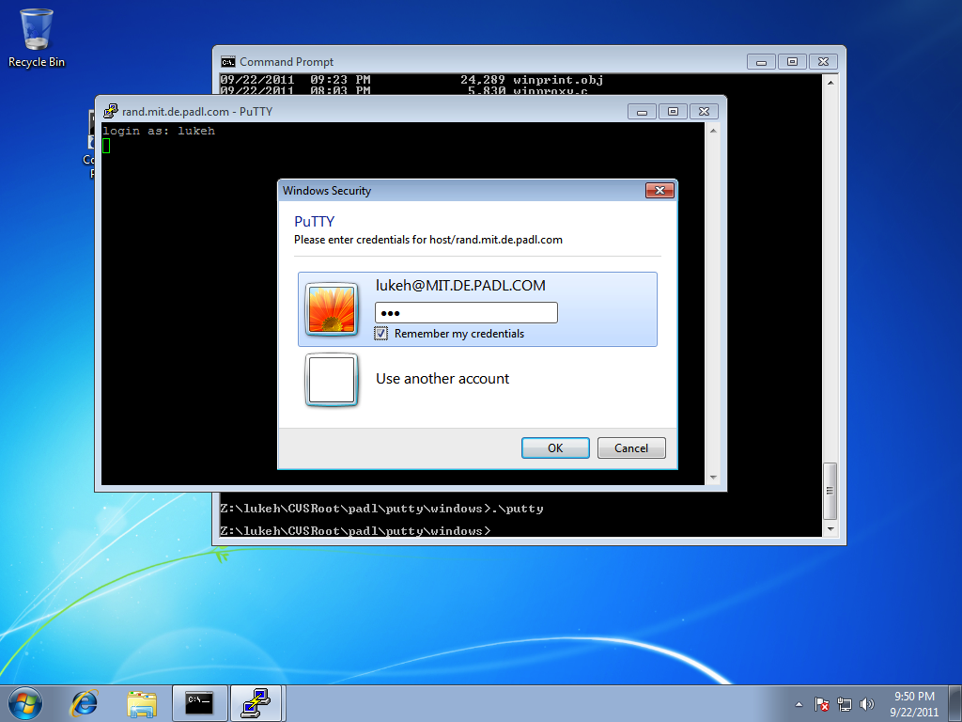
PuTTY → OpenSSH

Slide 26
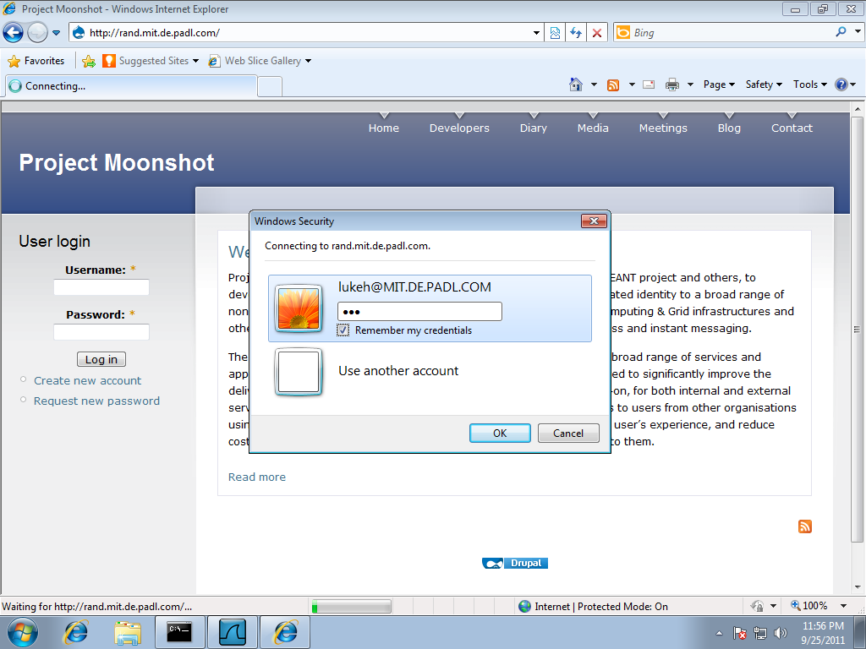
IE → Apache

Slide 27
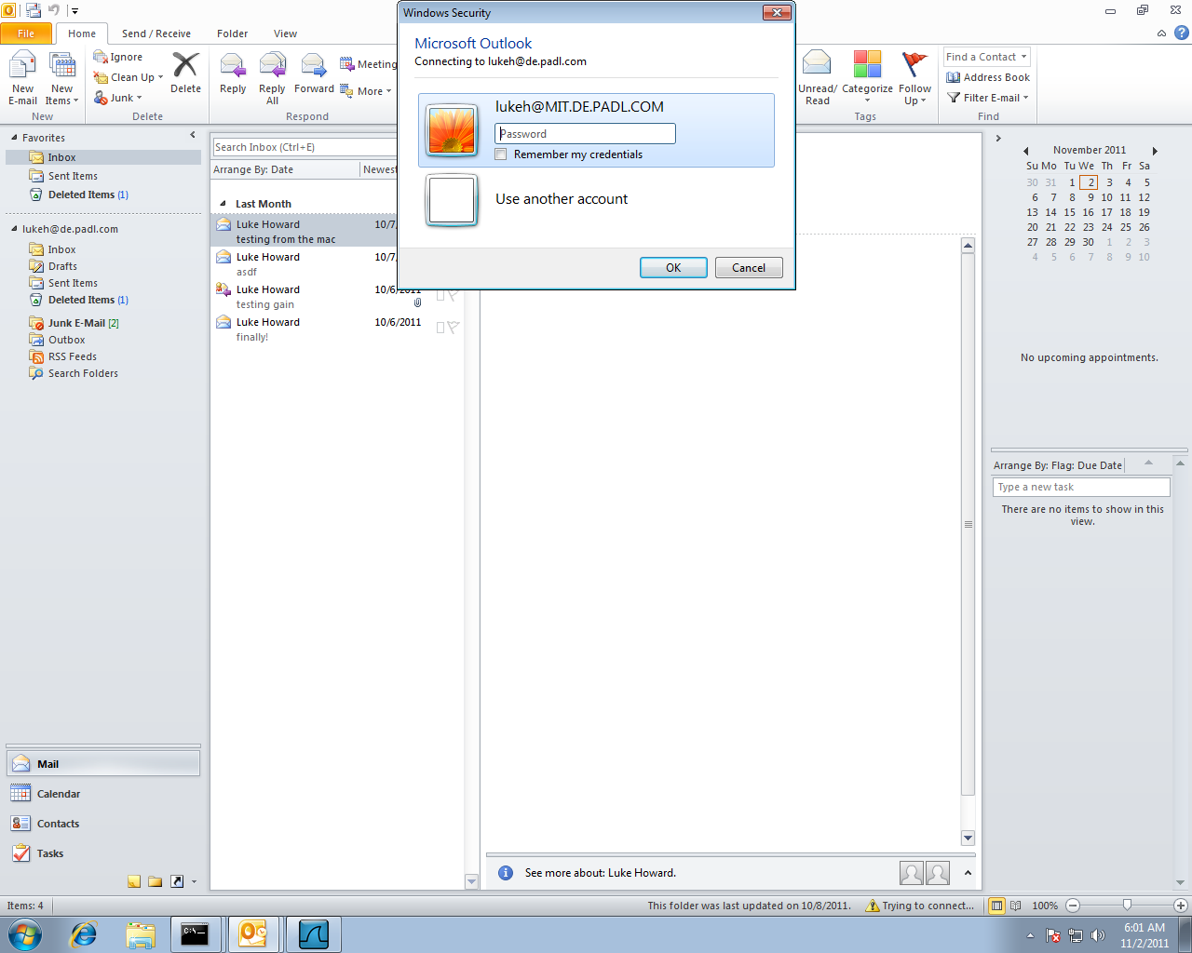
Outlook 2010 → Exchange 2010

Slide 28
Examples of other tested scenarios
OpenSSH client → OpenSSH server (GSS)
OpenLDAP client → OpenLDAP server (SASL)
OpenLDAP client (GSS) → Windows Active Directory (SSPI)
Firefox → Apache (GSS)
Internet Explorer → IIS (SSPI)
MyProxy client → MyProxy server (SASL)
Adium → Jabberd (SASL)
Console authentication using PAM/GSS on Linux and SSPI on Windows

Slide 29
Standardisation
The architecture is currently being standardised within the IETF’s ‘ABFAB’ working group
See https://datatracker.ietf.org/wg/abfab for documents
The key documents are
draft-ietf-abfab-arch describing the high-level architecture
draft-ietf-abfab-gss-eap describing the core “GSS EAP” technology
draft-ietf-abfab-aaa-saml describing the use of SAML

Slide 30
Really get involved!
https://community.ja.net/groups/moonshot/documents/draft-trust-router-specification - TR Functional Specification
http://community.ja.net/groups/moonshot - Project website: cases studies, background information, latest news, links to code repository
https://www.jiscmail.ac.uk/MOONSHOT-COMMUNITY is our community discussion mailing list
Implement Moonshot
Join the Service Pilot

Slide 31
Thank you

