Slide 1
Moving to a WPA2/AES only eduroam network - why continuing support for TKIP is bad news
Dr Alan Buxey
#nws41

Slide 2
How I Learned to Stop Worrying and Love AES
Dr Alan Buxey
#nws41

Slide 3
TKIP deprecation
Dr Alan Buxey
#nws41

Slide 4
TKIP end of an era
Introduction
History
Issues – security
Issues – work arounds
Issues – counter measures
Issues – mixed mode / 802.11n
Summary

Slide 5
TKIP is the next Dodo
TKIP deprecated by Wi-Fi Alliance
TKIP deprecated by eduroam
..but why the ‘hate’? Can’t we keep it?

Slide 6
TKIP – a brief history
TKIP (pron.: /ti:*kIp/) - Temporal Key Integrity Protocol
A security protocol used in the IEEE 802.11 wireless networking standard
Was a solution to replace WEP without requiring the replacement of legacy hardware
21/Oct/2002, the Wi-Fi Alliance endorsed TKIP under the name Wi-Fi Protected Access (WPA)
TKIP deprecated by the IEEE in January 2009

Slide 7
TKIP – how it works
TKIP is a suite of algorithms wrapping WEP
Same RC4 cipher
A cryptographic message integrity code (MIC) called Michael – stops forgeries
An IV sequencing discipline (remove replay attacks)
per-packet key mixing function (to separate public IVs from weak keys)
A rekeying mechanism (provides fresh encryption and integrity keys)
Notes:
IV – initialisation vector

Slide 8
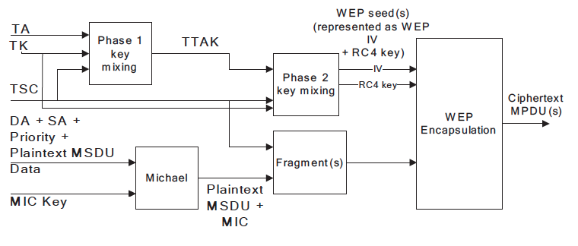
TKIP – where it ‘went wrong’
Destination Address (DA), Source Address (SA) ‘known’ apart from last byte
Only MIC and ICV to discover.
Modified ‘ChopChop’ attack to recover plain text
Diagram © http://hirte.aircrack-ng.org/tkip_master.pdf
Notes:
MIC – Michael
ICV – Integrity Check Validation

Slide 9
Remember WEP? RC4
FMS attack (2001)
KoreK attack (2004)
PTW attack (2007)
ChopChop attack (2008)
..and improvements – e.g. using KoreK correlations in the PTW method
Notes:
PTW - Tews, Weinmann, and Pyshkin
FMS - Fluhrer, Mantin and Shamir
KoreK – pseudonym

Slide 10
The soft-innards of your data stream
Previously, only small packets could be replayed “Beck-Tews attack” – 14 bytes, ARP poisoning, DoS etc
Improved by Halvorsen (with others) 596 bytes
Ohigashi-Morii attack – simpler and faster ‘similar’ attack and doesn’t require QoS (!)

Slide 11
workarounds
Reduce the re-key interval – lower than 15min (and hope clients don’t have reauth issues)
Disable QoS (WMM) – and watch the performance drop [and now pointless ☹ ]
..and rely on counter measures

Slide 12
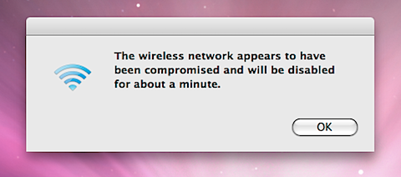
Counter measures?
MIC errors, 2 in the space of 60 seconds? TKIP clients are de-authenticated for the duration of the Countermeasure Holdoff time
Buggy clients can also cause this!
© http://www.deadlybloodyserious.com/2008/01/wireless-network-appears-compromised/
http://www.gossamer-threads.com/lists/cisco/nsp/136699 - Sept 2010

Slide 13
Mixed mode? WPA/WPA (TKIP/AES)
So you are running AES but kept TKIP for backwards compatibility?
(since March 13, 2006, WPA2 certification was mandatory for devices to have Wi-Fi trademark)
Group key is TKIP – as soon as a TKIP client joins, “all your ARPs are belong to me”
WPA2-Mixed mode will be removed in 2014. Only WPA2-AES is to be permissible from then on (WiFi Alliance)
..do you run 802.11n? (hands up)

Slide 14
802.11n – the 300mbit/450mbit promise
Fast speeds…but not if you have TKIP
Only ‘open’ or ‘AES’ get the top speeds (data rate drops to 54mbit with TKIP)
To use your investment you need to turn off TKIP

Slide 15
Summary
History (where TKIP came from, how it works)
Issues – security (attacks on TKIP)
Issues – work arounds (rekeying, no QoS/WMM)
Issues – counter measures (no radios!)
Issues – mixed mode / 802.11n (TKIP! no speed!)

Slide 16
AES-CCMP for standard service
Turn TKIP off completely, now.
Questions/feedback?
Notes:
Counter Cipher Mode with Block Chaining Message Authentication Code Protocol

