Slide 1
Welcome
Dr Alan Buxey

Slide 2
FreeRADIUS demystified
To make less mysterious; to remove the mystery from; make clear
Dr Alan Buxey

Slide 3
Tuesday seminar
Something new…… feedback welcome!

Slide 4
IT Services Network/Security Team, Loughborough
JANET Roaming support/development
UK eduroam federation representative
JANET Training Trainer (ICTP)
Consultancy (eduroam/802.1X,WiFi)
..but enough about me – what about you?

Slide 5
How many of you are running FreeRADIUS ?
Version 1 or version 2 ?
How many are thinking about FR?
eduroam member?

Slide 6
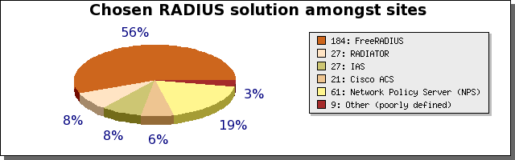
FreeRADIUS leads the field

Slide 7
A seminar of 3 parts
Examining the RADIUS packet flow
Best Current Practice (BCP)
FreeRADIUS 3
..then Coffee Break followed by
Quick talks / Q+A session

Slide 8
FreeRADIUS
Examining the flow

Slide 9
The first run...
From source or from distribution (RPM, PKG, DEB etc)
First step is to add a user – users file simplest way (follow the docs...) . Once walking, then we run... SQL, LDAP, AD, Proxy etc
username Cleartext-Password := “password”
..run ‘radiusd –X’ in a console...

Slide 10
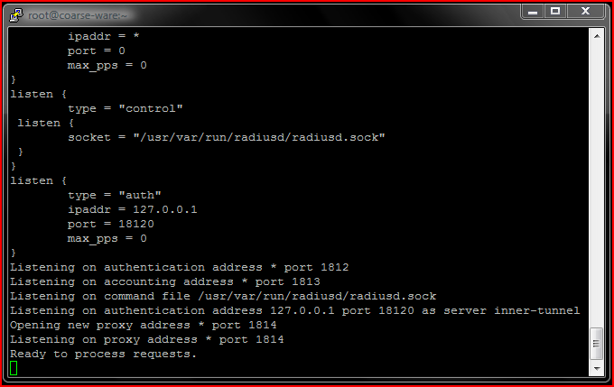
radiusd -X

Slide 11
Now fire a test at it from local server
eapol_test from wpa_supplicant package
network {
SSID = “eduroam”
key_mgmt=WPA-EAP
eap = PEAP
identity = “username”
anonymous_identity = “username”
password = “password”
phase2 = “auth=MSCHAPV2”
phase1 = “peapver=0”
}
Plenty of tests in sourcecode directory – src/tests !

Slide 12
results
EAPOL output
EAPOL: Successfully fetched key (len=32)
PMK from EAPOL - hexdump(len=32): 4e 20 53 15 d2 3b e4 e3 d5 c3 6e 39 56 20 4c f7 3a 94 0a 98 26 e4 6c 80 06 d3 b9 24 8a e2 87 37
EAP: deinitialize previously used EAP method (25, PEAP) at EAP deinit
ENGINE: engine deinit
MPPE keys OK: 1 mismatch: 0
SUCCESS
FreeRADIUS output
Sending Access-Accept of id 10 to 127.0.0.1 port 35433
MS-MPPE-Recv-Key = 0x4e205315d23be4e3d5c36e3956204cf73a940a9826e46c8006d3b9248ae28737
MS-MPPE-Send-Key = 0xe7f2ba3cf4310fba1bfc021ac1a1c5c4b3d9cba05985a6bc752eef97a75b4085
EAP-Message = 0x030a0004
Message-Authenticator = 0x00000000000000000000000000000000
User-Name = “username"
Finished request 10.
Going to the next request
Waking up in 4.9 seconds.
Cleaning up request 0 ID 0 with timestamp +16
Cleaning up request 1 ID 1 with timestamp +16
Cleaning up request 2 ID 2 with timestamp +16
Cleaning up request 3 ID 3 with timestamp +16
Cleaning up request 4 ID 4 with timestamp +16
Cleaning up request 5 ID 5 with timestamp +16
Cleaning up request 6 ID 6 with timestamp +16
Cleaning up request 7 ID 7 with timestamp +16
Cleaning up request 8 ID 8 with timestamp +16
Cleaning up request 9 ID 9 with timestamp +16
Cleaning up request 10 ID 10 with timestamp +16
Ready to process requests.

Slide 13
The server (overview)
VM1
VM2
Inner tunnel

Slide 14
The server (detail)
Pre-proxy
VM1
Post-proxy
Post auth
authorisation
authorisation
Post auth
Post auth
authentication
authorisation

Slide 15
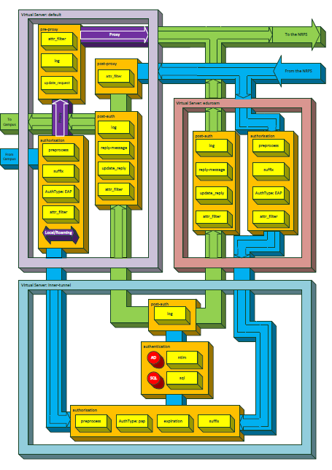
FR server (breakdown)

Slide 16
Decisions...decisions...
Packet arrives at the server. The server decides what virtual-server engine to pass packet through (based on client entry..IP address request came from..)
Passes through modules in the authorize {} section.
Decision made – Authenticate, Proxy, Reject
In this example, packet is EAP and so we pass to authenticate {} section – pass through modules until EAP – EAP-MD5 is default so an Access-Challenge is sent to the client. Request is finished.

Slide 17
Decisions continue..
The response arrives (its another request) and passes through the same virtual-server...and passes through authorize{} again..and then onto authenticate{}
Packet is NAK’d – client wants PEAP
PEAP Access-Challenge sent
Access-Request/Access-Challenges then continue (all passing through the same sections... Until we have the PEAP session
    [peap] Session established. Decoding tunneled attributes.
    [peap] Peap state TUNNEL ESTABLISHED

Slide 18
Decisions continue..
Server now ready to deal with the EAP contents ... ’innerID’
Next request request passes through the same virtual-server, the same sections...and then with INNER-IDENTITY we pass into the ‘inner-tunnel’ virtual server
[peap] Peap state WAITING FOR INNER IDENTITY
[peap] Identity - username
[peap] Got inner identity ‘username'
[peap] Setting default EAP type for tunneled EAP session.
[peap] Got tunneled request
EAP-Message = 0x0207000901616c616e
server {
[peap] Setting User-Name to username
Sending tunneled request
EAP-Message = 0x0207000901616c616e
FreeRADIUS-Proxied-To = 127.0.0.1
User-Name = “username"
server inner-tunnel {

Slide 19
Inner Space
In the inner-tunnel we go through the same process
authorize{}, authenticate{}
We match a user in authorize{} so go into authenticate {}
  [files] users: Matched entry username at line 86
We now do MSCHAPv2 (server configuration)
  [eap] EAP Identity
  [eap] processing type mschapv2
  rlm_eap_mschapv2: Issuing Challenge
Off goes another Access-Challenge

Slide 20
Access-Accept
Access-Request passes through to inner-tunnel again.. MSCHAPv2
challenge undertaken, we finally complete phase2
++[eap] returns ok
We now pass through inner-tunnel post-auth {} – all okay
MS-MPPE-* keys sent in PEAP success packet, Challenge sent
Final Access-Request arrives..passes through all the process
EAP-TLV response
Sending Access-Accept of id 10 to 127.0.0.1 port 54436

Slide 21
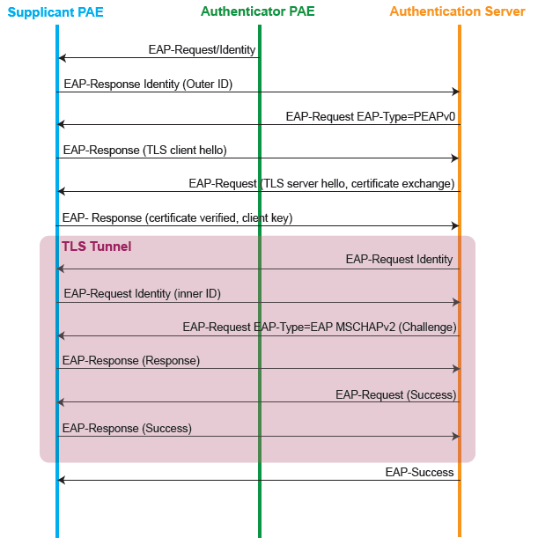
802.1X + EAP schematic

Slide 22
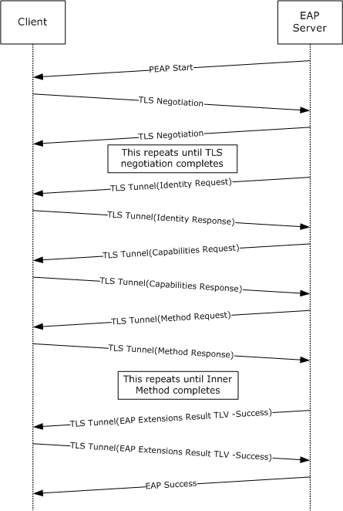

PEAP
Multi-step process (plenty of round-trips)
Very well documented ☺
Issues? There are a couple of note...

Slide 23
Possible issues...
Many packets – UDP, can be lost....smaller number of packets better
  PEAP - 11 or more packets in each direction.
  EAP-FAST, EAP-PWD, EAP-FASTv2 (aka TEAP) far fewer
Certificate chain size – larger packets can be fragmented more packets to be sent
  Server + CA – 3768 bytes
  Server + Intermediates + root – 6241 bytes

Slide 24
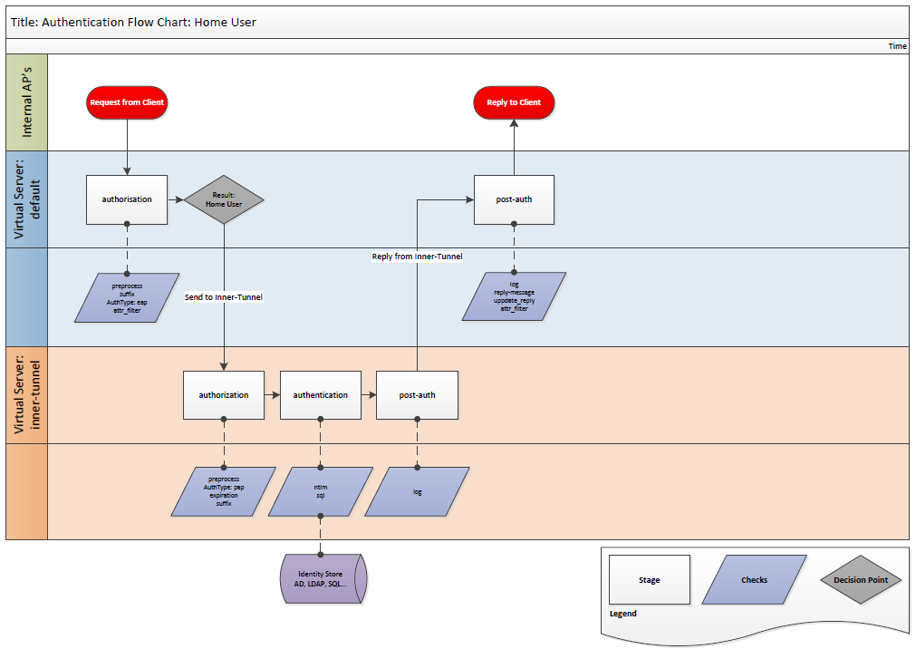
‘home’ authentication

Slide 25
Proxying
After authorize {} the packet is sent into pre-proxy {}
  NB modules in authorize {} are active...can affect outcome
Logging, Attribute filtering, Attribute rewriting or adding attributes
  Operator-Name added in this section
Request is sent to remote server
  NB server is synchronous – doesn’t act like a client. Its just a proxy.
Access-Challenge returned is funnelled into post-proxy {}
Logging, Attribute filtering, Attribute rewriting
Access-Accept passes locally through post-auth {} section
  Can e.g. Assign VLAN here

Slide 26
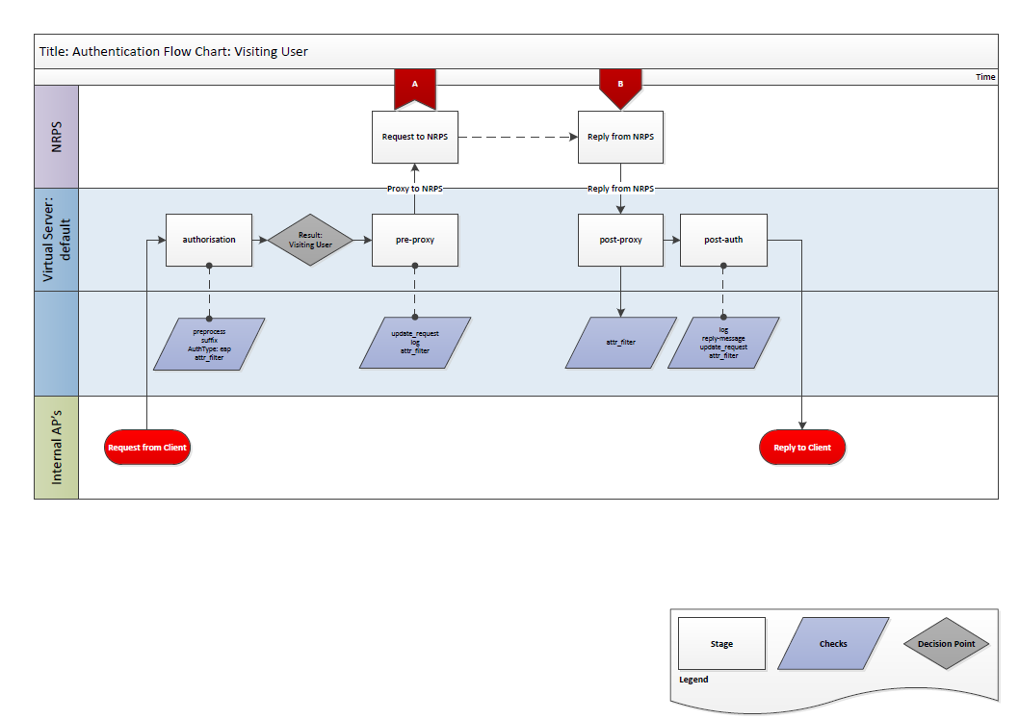
Proxied request (visitor)

Slide 27
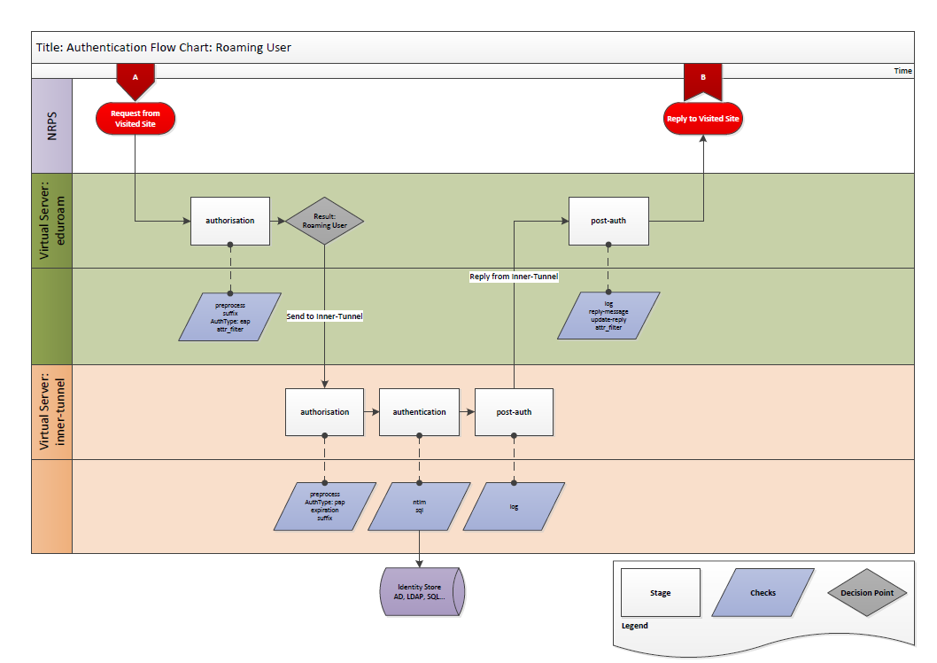
Proxied request (..at the home site)

Slide 28
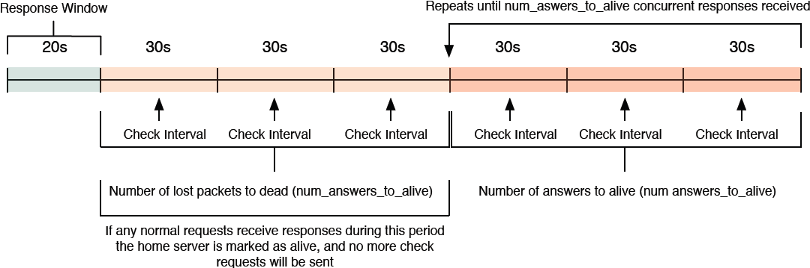
No response?
FreeRADIUS expects an answer from remote server within respnse_window (20s default) – if not, zombie_period is initiated (40s by default) if still no response, remote server marked dead.
...but remote server isnt the authenticator...its just a proxy – the problem lies further down the chain.
Status-Server - sends probes. Will get an answer from NRPS (*)

Slide 29
FreeRADIUS
Best current practice (BCP)

Slide 30
Overview
Best Current practice for home or visited site
Mainly looking at the proxying/eduroam aspect
Local requirements, historical configuration or version being run may affect your ability to follow BCP
This is for FR 2.1.12..and should be fine with FR3
  Some parts are specific to virtual-servers and ‘unlang’

Slide 31
Virtual-Server
One of the core assets of FreeRADIUS
Not XEN/VMware style – it’s like Apache host definitions
3 default servers with 2.1.12
  default, inner-tunnel, control-socket
Many others waiting to be used – eg VMPS, DHCP
Create a new VS – ‘eduroam’ for requests that come from the NRPS
Can be very minimal – just needs to authenticate users and deal with accounting

Slide 32
eduroam VS (minimal)
server eduroam {
authorize {
preprocess
suffix
ntdomain
auth_log
eap {
ok = return
}
}
authenticate {
Auth-Type EAP {
eap
}
}
preacct {
preprocess
acct_unique
suffix
ntdomain
}
accounting {
if (Acct-Session-Time != 0) {
detail
}
else {
ok
}
attr_filter.accounting_response
}
post-auth {
reply_log
Post-Auth-Type REJECT {
attr_filter.access_reject
}
}
# end of eduroam VS
}
client roaming2.ja.net {
secret = secret
nastype = other
shortname = NRPS2
virtual_server = eduroam
}
Requests from roaming2.ja.net wil now go through the ‘eduroam’ server – avoiding all other logic/rules/methods

Slide 33
‘named’ modules
FreeRADIUS comes with many modules to perform functions
You may need to use e.g. MySQL from various Virtual-Servers – the one module would have the same functions
Name the module
sql {} becomes e.g.
sql eduroam-sql {} and sql internal {}
Now call eduroam-sql {}
in the eduroam VS

Slide 34
Attribute filtering
Used to having control of you own servers...you set the attributes for your NAS (e.g. To place user on a VLAN)
When request proxied off, the REMOTE server can be setting things
Might be okay if they are using different kit (VSA might not match) but bad news if using same kit
Uncomment the filtering in pre-proxy and post-proxy
Edit the filters to match
JRS Technical Specification

Slide 35
Only proxy valid users
Over half of the traffic the NRPS deal with is junk.
username@realm.uk.ac username@realm username@realm.ax.UK username@realm.ac.uk username@realm..ac.uk username@realm.ac.k
DON’T use the DEFAULT in proxy.conf – use unlang to check the username is valid and then update the control to point to a proxy pool e.g. ‘eduroam’

Slide 36
Valid users..
e.g.
“FreeRADIUS at Sussex University” guide (being revised)
..use Policy
if( ("%{User-Name}" =~ /\\\\?([^@\\\\]+)@?([-[:alnum:]._]*)?$/) && ("%{User-Name}" !~ /@yourrealm.ac.uk$/) ) {
update request {
Realm := "eduroam"
}
update control {
Proxy-To-Realm := 'eduroam'
}
}

Slide 37
Policy
Policy.conf contains lists of rules...can use this file to create rules e.g.
  Does username/realm contain whitespace?
  Does realm end in whitespace or contain illegal characters?
  Are there multiple @’s
  Is it a ‘valid realm’ (has at least one . )
  Does the realm have double dots – realm..ac.uk?
  ax.uk ? @ac.uk ?
  3gppnetwork.org or myabc.com ?
Can simply name a rule e.g. ‘valid_eduroam_user’
Call that from authorize {}

Slide 38
Proxy pool
2.x and up have home_server pool definitions in proxy.conf
There are 3 NRPS – ensure that all 3 are listed (ensure that all 3 are in clients.conf too!)
There are 3 NRPS – so use them.
  “client-port-balance” is the best method ATPIT
require_message_authenticator = yes (RFC 5080)

Slide 39
Reduction of inner authentication load
Using SQL/LDAP? Common problem is multiple hits to your authentication server.
There has been work to reduce this but simple fixes
Only do the query when needed – one point in EAP
In inner-tunnel authenticate {}
66% reduction...and faster responses!
if ((EAP-Type == 1) || (EAP-Message =~ /^0x02..00061a..$/)) {
noop
}
else {
sql
}

Slide 40
Remove unused modules
Once you have a working, tested/verified server you can do some ‘spring-cleaning’
Each module removed is one less call to code..can remove quite a bit of wasted resource usage...some modules have background behaviour – large files created that hit a performance plateau/cliff
Always have a working server before you start to strip config
Some obvious (unix), some not so.... [noop] *all* the time?

Slide 41
Monitoring
Production service – monitored as standard
NAGIOS/OrionNPM/Zabbix/OpenNMS etc have RADIUS plugins
Monitor local authentication and remote authentication
  realm.ac.uk@eduroam.ac.uk – each Organisation has remote test account handled by the JRS support server
Monitor the local server too – disk space, processor usage, memory free etc – Munin/NAGIOS NRPE/SNMPD etc
Monitor the daemon – e.g. ‘Monit’ will alert and restart
FreeRADIUS has status information that can be viewed by control-socket and status virtual servers... Munin plugin

Slide 42
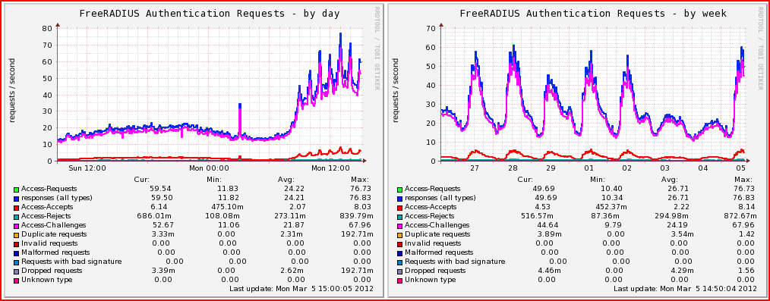
Munin graphing
Trends / usage / weirdness..

Slide 43
FreeRADIUS 3
The Next Generation

Slide 44
FreeRADIUS 3
Some major changes in features/methods
Some minor tweaks to configuration
NOT 100% configuration compatible

Slide 45
The initial move
Before we examine new features lets look at the basic migration to 3.x
What/where are the differences for a basic migration?

Slide 46
Files that have moved (top level)
modules directory -> mods-available
(just like sites-enabled in FR 2.x)
eap.conf -> mods-available/eap
sql.conf -> mods-available/sql
sqlippool.conf -> mods-available/sqlippool
Active modules are links from mods-enabled/ directory
New file – trigger.conf – discuss later (it may move anyway…)

Slide 47
Connection pools
New method of connecting to services (e.g. SQL)
..can deal with services coming and going, things should ‘pick up from where they left off’
  sql.conf new pool {} section
  num_sql_socks max
  connect_failure_retry_delay *gone*
  lifetime lifetime
  max_queries uses
REDIS module also uses this…LDAP doesn’t yet

Slide 48
New Virtual Servers available
3 new virtual servers
‘tls’ – ‘RADSEC’ (RADIUS using TLS over TCP)
  Can receive and send.
  Documentation prepared – should be published
  ‘radiusd –fxx –l stdout’ is the ‘radiusd –X’ of the future…
dhcp.relay – handles relaying of DHCP
check-eap-tls – can reject EAP-TLS based on certificate values eg
  TLS-Client-Cert-Subject
  TLS-Client-Cert-Issuer
  TLS-Client-Cert-Common-Name
  TLS-Client-Cert-Subject-Alt-Name-Email

Slide 49
New EAP layout
eap.conf has had some change of layout
  ‘tls-config’ section – can define different environments…
  ‘tls-config tls-common’ predefined (the ‘old tls’ section as it were…)
  Then, for each EAP method, you can pull in required tls config
    E.g. in TTLS section , ‘tls = tls-cmmon’
3.x can still read 2.x version of eap.conf (at time of writing!)
  BUT you cannot mix and match…cannot have ‘tls = config’ if old tls {} section exists

Slide 50
New EAP methods
EAP-PWD (RFC 5931) now supported
  Requires OpenSSL with ECC support
    OK for Ubuntu/Debian/SUSE
    NOT OK for RHEL/CentOS – no support for this...
  A quite significant client OS may soon have this...
TLS in PEAP and TLS checking improved – Matthew Newton
NB SoH – Status of Health...appeared in 2.1.11 but often looked over if migrating configs... there in 3.x – Phil Mayers
  MSCHAPv2 password incorrect inform.... 2.1.11
  FR 3.x can now enact a password change (depending on backend configuration... ‘passchange’ in mschap module

Slide 51
New EAP methods – results..
Sending Access-Accept of id 10 to 127.0.0.1 port 51618
MS-MPPE-Recv-Key = 0xcb89900ace78ce497ac4671bde6cfc413aa02e88d7a28e7872732511ba10b170
MS-MPPE-Send-Key = 0x44bed1a88ad802cbe5d5079c9075acde82624e00a6ba8e07ed76e78347f6a9b9
EAP-Message = 0x030a0004
Message-Authenticator = 0x00000000000000000000000000000000
User-Name = "anonymous"
(10) Finished request 10.
Waking up in 4.5 seconds.
(0) Cleaning up request packet ID 0 with timestamp +7
(1) Cleaning up request packet ID 1 with timestamp +7
(2) Cleaning up request packet ID 2 with timestamp +7
(3) Cleaning up request packet ID 3 with timestamp +7
(4) Cleaning up request packet ID 4 with timestamp +7
(5) Cleaning up request packet ID 5 with timestamp +7
(6) Cleaning up request packet ID 6 with timestamp +7
(7) Cleaning up request packet ID 7 with timestamp +7
(8) Cleaning up request packet ID 8 with timestamp +7
(9) Cleaning up request packet ID 9 with timestamp +7
(10) Cleaning up request packet ID 10 with timestamp +7
PEAP - 11 packets in this test environment. 0.2s
Sending Access-Accept of id 3 to 127.0.0.1 port 40733
MS-MPPE-Recv-Key = 0x1a680403ff96516ca3ecdde78decebb2a4d3539a3fb12caec627a08bcdaa14dc
MS-MPPE-Send-Key = 0xbc226dbf2014eb2d90413c81c29f555c539b3f06cd7a8afd02da3fa74063c45b
EAP-Message = 0x03030004
Message-Authenticator = 0x00000000000000000000000000000000
User-Name = "fred"
(3) Finished request 3.
Waking up in 4.6 seconds.
(0) Cleaning up request packet ID 0 with timestamp +2
(1) Cleaning up request packet ID 1 with timestamp +2
(2) Cleaning up request packet ID 2 with timestamp +2
(3) Cleaning up request packet ID 3 with timestamp +2
EAP-PWD - 4 packets in this test environment - 0.07s
(its CPU heavy - plain EAP-MSCHAPv2 is 0.02s)

Slide 52
Triggers
trigger.conf – in raddb top level directory (may move)
Events in the server can now trigger a hook
  E.g. Server stop/start or home server alive/dead, SNMP trap can be sent
Only known entries can be used...cannot just make them up – need to code them into the server. Need to copy MIBS into the global directory.
They are going to prove very useful (my belief)

Slide 53
auto_limit max_pps
Accounting a problem with slow back-ends... A flood of accounting data can cause issues.
FR 3 can limit number of packets handled...and silently drop excess packets.. NAS will retransmit the accounting packet.
1 second tracking window – helps to deal with overloading
auto_limit_acct - a set number..if number of packets received is higher than this AND the process queue is more than half full, then new packets are discarded – giving server chance to recover

Slide 54
Housekeeping..
In radiusd.conf some security options have moved to security {} subsection
  chroot, user, group, allow_core_dumps, reject_delay, status_server
  If you use any of these (and you should) then they need to be called in security {} section and not anywhere else in the file.
certdir and cadir have been turned into global defines – they can now be set once and reused in eap.conf AND ‘tls’ virtual-server

Slide 55
New state machine in the server core
“The old state machine was an inter-connected mess that was getting to be impossible to extend or debug. The new one is much, much, better.” – Alan DeKok 13 Apr 2011
about the same amount of code as the old one (state machine)
conceptually much simpler
all of the functionality of the old one...
  .....hopefully none of the bugs ;-)

Slide 56
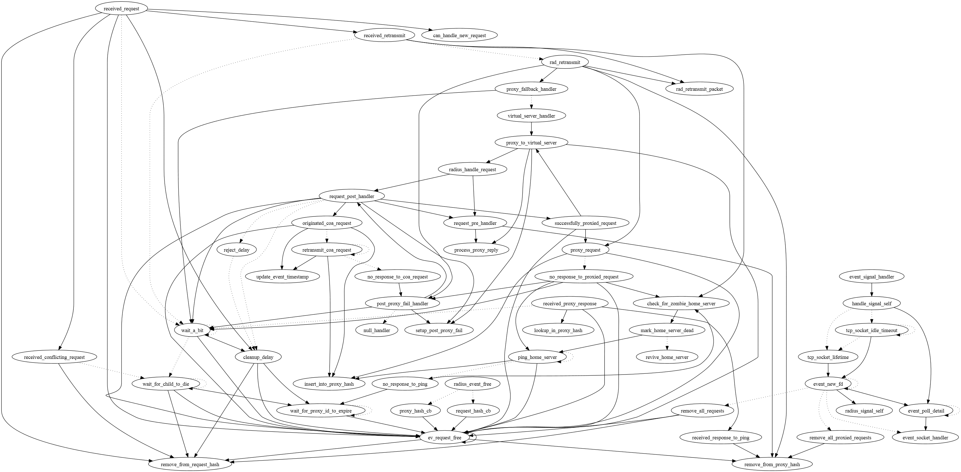
Old state machine

Slide 57
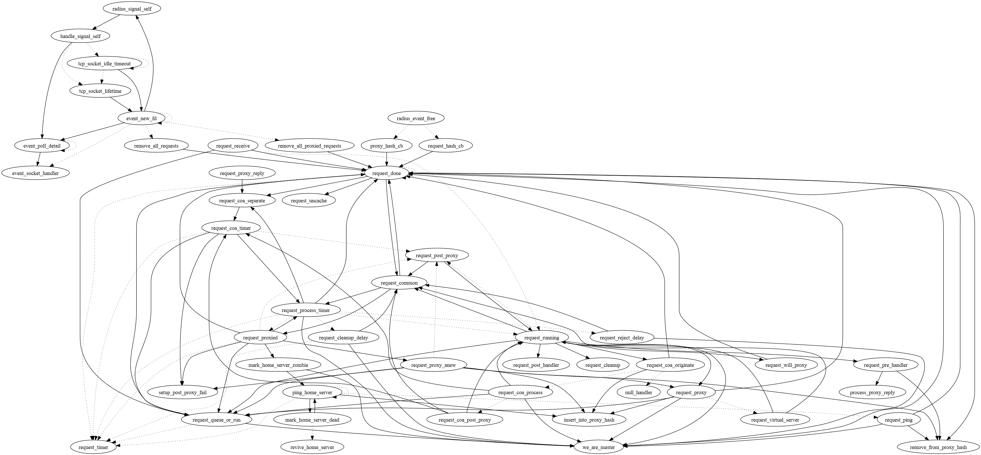
New state machine

Slide 58
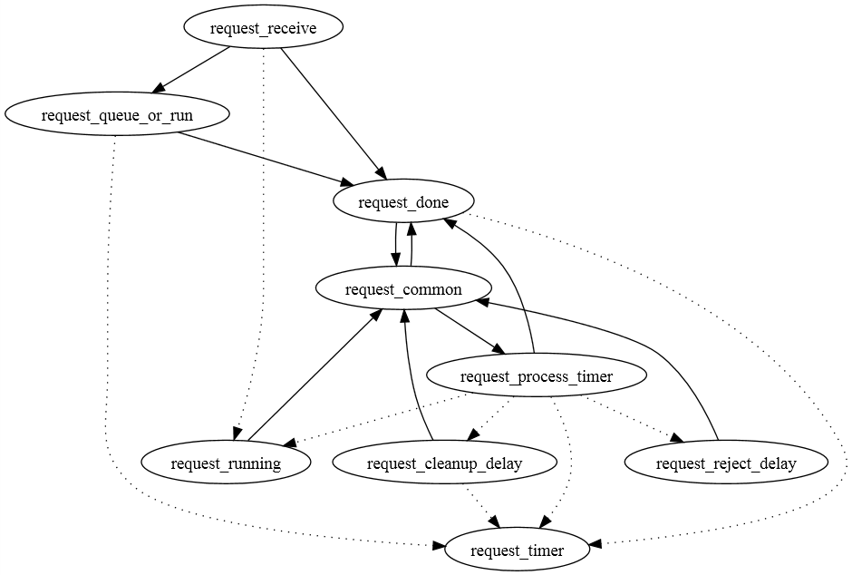
New state machine – simplified
(Book-keeping, Proxy and CoA functions removed from schematic)

Slide 59
New state machine – advantage
A state machine that handles authentication / accounting / coa requests, processes them and replies.
A state machine that is much simpler
Now have the ability to debug the internal state machine.
  Define a flag DEBUG_STATE_MACHINE
(it will then print out every state transition that a request goes through – helping to understand how things work)

Slide 60
Networkshop2012 / NWS40
eduroam queries/support
Alan Buxey / Scott Armitage
http://www.ja.net/nwsmobile

Slide 61
Thankyou...
...Questions?

