Slide 1
Mobile Technology
JANET(UK)’s current strategy
Mark O’Leary, Aberdeen, January 2011
Notes:
25 years

Slide 2
The Challenge
Education delivery is no longer simply ‘chalk and talk’
  Delivery on location
  Supporting group work
  Distance learning
  24 hour delivery
  VLEs

Slide 3
The Answer?
We need a connectivity solution that is:
  Ubiquitous
  True broadband
  Reliable and secure
Notes:
Alternatively:
£47m from funding
£13m from revenue streams

Slide 4
The Candidates
Wi-Fi (i.e. eduroam) 
WiMax 
LTE 
3G 
Notes:
Provisioning instead of QoS

Slide 5
Wi-Fi
‘vanilla’ eduroam: proper broadband, well understood technology, but not nation wide.
eduroam meeting support
Self-configuring eduroam visited service
eduroam on public transport

Slide 6
WiMAX
Mobile broadband evolution of WiFi-like technology
Licensed spectrum
Expensive hardware
No national infrastructure

Slide 7
LTE
Mobile broadband (long term) evolution of telephony data technology
Lags behind WiMAX, but:
Telephony providers comfortable with the technology
Therefore infrastructure seems likely in the future…

Slide 8
3G data
The only viable near-pervasive, nation-wide option
But:
Not really ‘broadband’
User experience generally poor
And…

Slide 9

The 3G data apocalypse
=
=

Slide 10
Apocalypse now
By 2013, 30% of all notebook/tablet computers will be sold bundled with 3G data plans.
Given sales worldwide of ~150 million units a year, that's 45 million new 3G notebooks a year.
  … the data equivalent of adding 20 billion more feature phones to the network, every year.

Slide 11
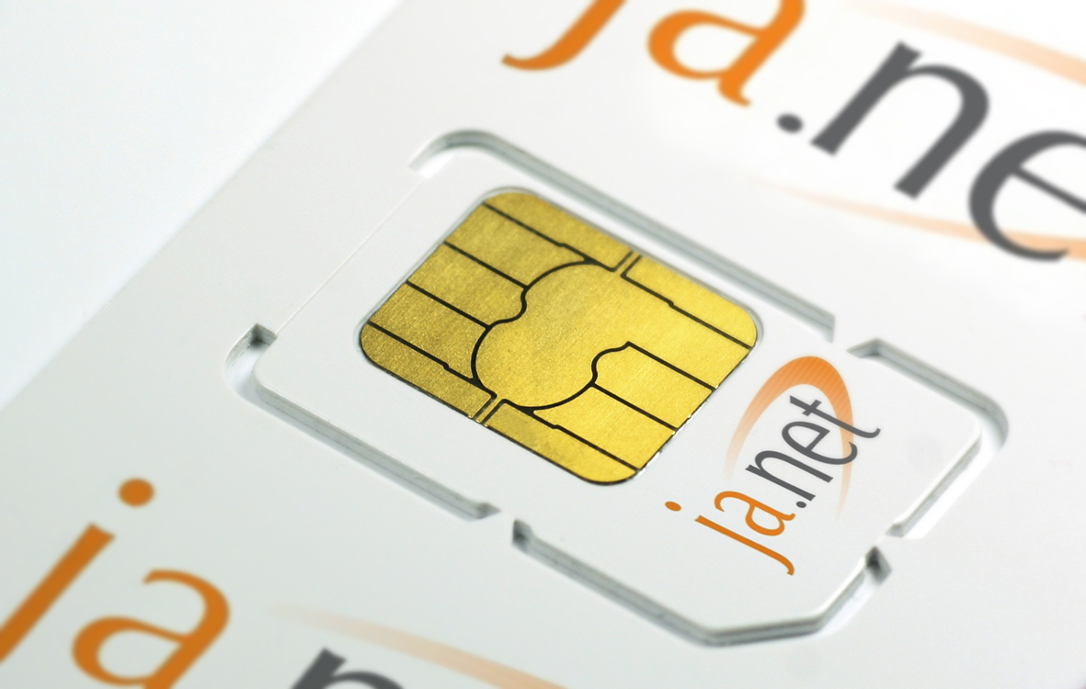
JANET 3G
Procurement in progress…
Integrated with eduroam
Assign home organisation IP addresses to roaming users, simplifying security model
Charging plans tailored to the sector (M2M, low usage)

Slide 12
So, short term strategy
eduroam wherever possible
3G service everywhere else
Ongoing exploration of partnerships with wireless ISPs

Slide 13
Longer term
LTE to supercede 3G for interactive uses
Possible integration of wireless with the JANET Core (SIX)?
Secured wireless shared services in a PSN context?

Slide 14
In other words…
Martini Networking for all!
Questions?
mark.o’leary@ja.net

